Slide 1
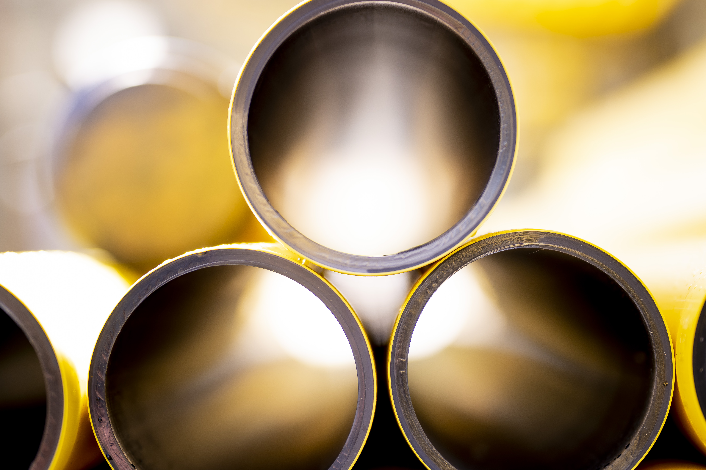
Wales & West Utilities: Business Panel Research Wave 1
Wave 1 Final Report, October 2023

Slide 2
Background
Sample Overview
Thinks Insight conducted a welcome event and online community with 29* micro and small businesses between 6th and 13th September.
The online community explored the context of micro and small businesses as well as their previous experiences with Wales & West Utilities (WWU), and introduced WWU’s pipe replacement programme and emergency service.
This was followed by an online committee meeting with 6 members of the panel. The group were presented with the findings from the online community to add further insight.
This report sets out the findings from both phases, and offers recommendations based on these insights.
Welcome event and online community:
15 micro businesses
14 small businesses
4 in North Wales
10 in South Wales
15 in South West England
5 charities
5 in social care
10 in hospitality
9 in other sectors, including retail and construction
Committee meeting:
3 in South Wales
3 in South West England
1 micro business
5 small businesses
1 in charity
2 in hospitality
1 in retail
1 in care
1 in other
*Note: One participant did not complete the Recollective activities making the sample size throughout the report 28.

Slide 3
Key findings
1
2
3
The overall context for businesses is challenging and uncertain, with rising costs and staffing issues major concerns for business owners across sectors. Therefore, gas is mainly a financial concern, seen within this wider context of rising bills, and is otherwise not a salient topic for business owners.
In the context of uncertainty, businesses need clarity on how long and in what way their business will be affected by planned maintenance work. They can plan for this, but they can’t plan for surprise roadworks.
Overall awareness of WWU is fairly high, but familiarity is shallow, with most business owners only aware of WWU due to seeing vans and signs in their local area.
4
5
6
Across the board, feelings towards WWU are neutral. Where participants have had less positive experiences, these could have been improved with more prompt and direct communication with business owners.
Pipe replacement work is understood as important for future proofing the gas network and improving reliability, while also having a positive impact on the environment.
Business owners are pleased with WWU exceeding targets to respond to emergencies but are less comfortable with repairs. They are unclear on what to do in the event of a gas emergency themselves.

Slide 4
Business context

Slide 5





It’s a challenging time for many businesses
Increased costs
Staffing issues
Road closures
Business owners across all sectors are concerned about rising business costs in the context of the cost of living crisis.
Those in the retail sector are particularly concerned about the cost of importing goods, with some attributing this to Brexit.
Those in hospitality are concerned about the rising cost of food and drink, forcing them to pass costs on to their customers.
Business owners are also concerned about attracting and retaining staff and how much they’re able to pay them in the current climate.
Keeping up staff morale is a priority for many business owners.
This is particularly true for those working in the social care such as nurseries and the charity sector.
For business owners that have been affected by road works in their area, this has resulted in a significant business challenge, with increased traffic and disruption putting off customers and affecting footfall.
For many this has caused more uncertainty for their business at an already difficult time.
The main challenge is increased cost of operation due to many factors. This has led to difficulty staying competitive with my pricing.
In the care industry staffing is a huge challenge but it’s been more of a challenge over the last 12 months with carers leaving the sector.
There was work being done directly outside our venue… you couldn’t even see the venue so it had a big impact on business.

Slide 6
When it comes to their gas supply business owners are primarily only thinking about the cost of gas
The cost of energy is a front of mind concern with business owners feeling the impact of rising costs across many of their business expenses. Many are considering how they can reduce their usage and are worried about prices continuing to rise as they prepare to use more energy in the winter. Some feel forced to start passing increased costs on to their customers.
My utility bills have increased so much that I have had to raise my prices and reduce my profit.
Businesses feel more familiar with their retailer and there is a mix of knowledge about GDNs and Wales & West Utilities specifically. Most have seen their vans or signs when out and about.
I didn’t think about the distribution of gas, I assumed suppliers did that. I wasn’t aware of WWU.
Gas leaks and other emergencies aren’t front of mind.
Truthfully my biggest concern about my gas supply is the cost of it continuing to increase and us being unable to afford to heat our premises or pay our bills.

Slide 7

Case study: Lucy*
Lucy runs a cafe serving food and drinks. Her business primarily uses gas in the kitchen, and they’ve never had any issues with their gas supply.
Lucy has found that over the last 18 months her business expenses have risen sharply, particularly utilities, food and coffee.
As these expenses continue to rise, her profit margins are dwindling and she is worried about the future of her business.
Despite changing the menu to use less costly ingredients and less gas for cooking, things are still challenging, as customers are also feeling the pinch and therefore spending less money on eating out.
The number of customers coming through the door has dropped. This could be for a number of reasons, including reduced income. Lunchtime trade has dropped in particular with fewer people out and about in town.
The price of coffee is going up as well as general import costs… We’re looking at changing our menus so we don’t have to use cookers and can use cheaper ingredients.
The average spend of our customer base has reduced per head as their disposable income reduces. Customers are typically only having a drink or sharing a cake, not spending as much on lunches.
*Names and photos have been changed to protect anonymity

Slide 8

Case study: David*
David runs a wildlife charity that takes in injured animals and rehabilitates them until they’re ready to be released back into the wild.
His business primarily uses gas for heating, hot water and cooking. This is particularly vital for his business because his team need to keep the wildlife warm while there are recovering or at a young age.
Wales & West Utilities carried out pipe replacement work in the area around David’s business, and the traffic caused by the works affected access to their rescue centre. This also restricted volunteers transporting wildlife and supplies to the rescue centre. This had a significant impact on their business.
David only found out about it from signs at the site when the work started so he didn’t get time to prepare for the disruption it caused.
Wales & West Utilities have been carrying out pipe replacement works in our local area and this has affected us getting to our sister rescue we work alongside. Although we have been able to access it, the traffic and delays due to temporary traffic lights have made it challenging. We often deal with emergencies and every minute is vital so it is frustrating to be caught in traffic.
I don't dislike WWU, and it isn't their fault that the road works need to go ahead, but it is frustrating when it affects the work you are trying to do.
I think it would be really nice to have a more personal touch by delivering a letter or email for the businesses or homes it is affecting rather than just signs in the road.
*Names and photos have been changed to protect anonymity

Slide 9

Case study: Julia*
Julia runs a nursery and primarily uses gas for heating and hot water.
One of the biggest challenges for her business at the moment is keeping up with staffing costs and retaining the staff she needs in the current cost of living crisis.
She first heard about Wales & West Utilities when she noticed them carrying out work in the street outside the nursery. This made it difficult for parents to pick their children up on time and meant she had to pay her staff overtime.
Wales & West Utilities didn’t specify how long the work would be carried out for, making it difficult to budget and plan rotas.
My nursery is in the town centre and we’re affected by the road closures. It may be something as small as parents being late to pick up their children so I have to pay staff overtime to look after them.
if I had communication about roadworks I’d be able to message parents in advance to let them know pick up times etc.
*Names and photos have been changed to protect anonymity

Slide 10

Case study: Max*
Max runs a cafe that opens seven days a week. His business primarily uses gas for cooking and heating.
Although max has never had an issue with his gas supply, maintenance took place near his business which affected operations.
However, he was pleased that he and the other businesses and homes in the area knew about this in advance via a letter from WWU. He was particularly impressed when he received a personal visit to the premises to confirm when he would be impacted.
Later on, he received another letter to advise when his gas would be switched off. It was switched back on again straight away after work was completed.
He felt that although business was affected, WWU had done everything they could to support him to plan around the disruption.
I was most impressed when one of the workers visited every house affected and explained what WWU were doing and apologised for any inconvenience.
I initially received a letter advising me of proposed work.
Later I received a visit to confirm when I would be impacted.
If planned, then communication is the key. Contingency plans can then be put in place for access or disruption to the supply.
*Names and photos have been changed to protect anonymity

Slide 11
Experience with WWU

Slide 12
Most business owners were aware of WWU prior to this research
Business owners are generally aware of WWU from vans and signs that they have spotted around road works in their local area, but their knowledge of what they do does not extend far beyond this.
Upon learning the distinction between their retailer and GDN, business owners think it is important for customers to understand the difference for two key reasons:
Issues and emergency response: Knowing who is responsible in case of a problem or query would be helpful.
Reputation: Knowing more about who benefits from recent price hikes and subsequent profits, may lead customers to view WWU more favourably.
Business owners would like to see WWU proactively communicate with them more, particularly about gas safety and what to do and who to contact in the event of an emergency. They see their bills as a good place for this information.
I have seen their vans all around Yeovil where the roads have been dug up with gas pipes being replaced.
I only know of the name due to road closures in Henleaze.
Q: Before being invited to this research had you heard of WWU? n=28

Slide 13
Overall, business customers report a neutral or positive experience with WWU
While experiences are positive, some business owners who have been affected by WWU’s maintenance work received little or no communication beforehand. They feel that direct communication from WWU, ideally about a month in advance, would have allowed them to plan accordingly.
12 out of 28 business customers have experienced some sort of gas incident.*
12/28
have experienced a gas incident
I’ve had an experience where there was an issue on the street, and I couldn’t get access to my premises as easily. Customers also complained too… [There was] no communication.
19 business customers have had contact (including incidents) with WWU with 15 reporting this contact as being neutral or positive.*
15/19 reported a neutral or positive experience
Recently WWU had to replace sections of pipework in the road and to the houses in my area. I was most impressed when one of the workers visited every house affected and explained what WWU were doing and apologised for any inconvenience.
Q: Have you ever experienced a gas incident(s) (e.g. loss of supply, leak, roadworks/access issues etc) that affected your business? N=28
Q: Based on the experience/interaction you told us about in task 3, how did you feel about Wales and West utilities? N=19
* See appendix for full poll results

Slide 14
Business owners stress the importance of communication if there is going to be disruption
Business owners understand that WWU needs to carry out work when there are issues with the infrastructure, and that this inevitably causes disruption. However, some business owners who have been affected by WWU’s work explain that they received little to no communication about the work taking place, with some only finding out when they saw the work begin. Business owners need:
Direct contact from WWU at least a month in advance.
What disruption they can expect, for example, traffic from road works, closed pathways, etc.
The length of time they can expect disruption, with regular updates.
This enables them to plan business activities in advance such as mitigating against any potential risks, for example a loss of trade, by planning access to the site for customers and staff, and informing customers before the work begins. Where there has been disruption, negative perceptions arise from a lack of communication rather than the disruption itself.
Whilst it does cause disruption I would rather the work is done and as long as we know about a month before work is due it gives me sufficient time to inform staff and services users.
I appreciate that the work is necessary and as long as I’m aware of how long it will affect me then I’m happy with that.
The work was carried out directly outside our doorway and made it difficult for customers to see that we were open. We did receive letters about this work, but it didn’t specify quite how long the work was going on for.

Slide 15
WWU’s pipe replacement programme

Slide 16


Business owners are positive about replacing gas pipes, particularly from an environmental perspective, but some aspects are concerning
The panel like that there is a long-term plan to update the gas network. They think that investing in this now will mean less disruption in the future.
They feel that the updates will make the network safer.
They are positive towards the work reducing emissions and therefore having a positive impact on the environment.
Some panel members have questions about the durability and longevity of plastic pipes, as well as their environmental impact.
Some feel they need more information on how the date of 2040 has been decided upon.
The panel have some concerns over the timeframe. Some feel that 2040 is long way off, and the work could be subject to delays causing further disruption to businesses.
It's reassuring to know that the business is always working towards a better environment and striving for durable operations.
I was shocked to hear that plastic pipes are being used when the world is so anti- plastic!
2040 is a long time away – I’m concerned that the programme will be dragged out.

Slide 17
Business owners prefer replacement work to be done quickly, even if this means it will cost more, to minimise disruption
Business owners feel that completing pipe replacement work as quickly as possible, even if it means increasing the workforce and associated costs, is the priority as they are most concerned about minimising disruption to their business.
While some business owners are more concerned about the cost of the work, there is generally more concern about the financial consequences of extended periods of disruption, and the impact this can have on profitability.
With previous experiences in mind, some business owners are less concerned about the cost and time but want WWU to notify them well in advance.
Thinking about the Wales and West Utilities' pipe replacement work, what would be most important to you?
The longer it takes the longer the business interruption - as a business owner, this is critical.
Q: Thinking about the Wales and West Utilities' pipe replacement work, what would be most important to you? n=28

Slide 18
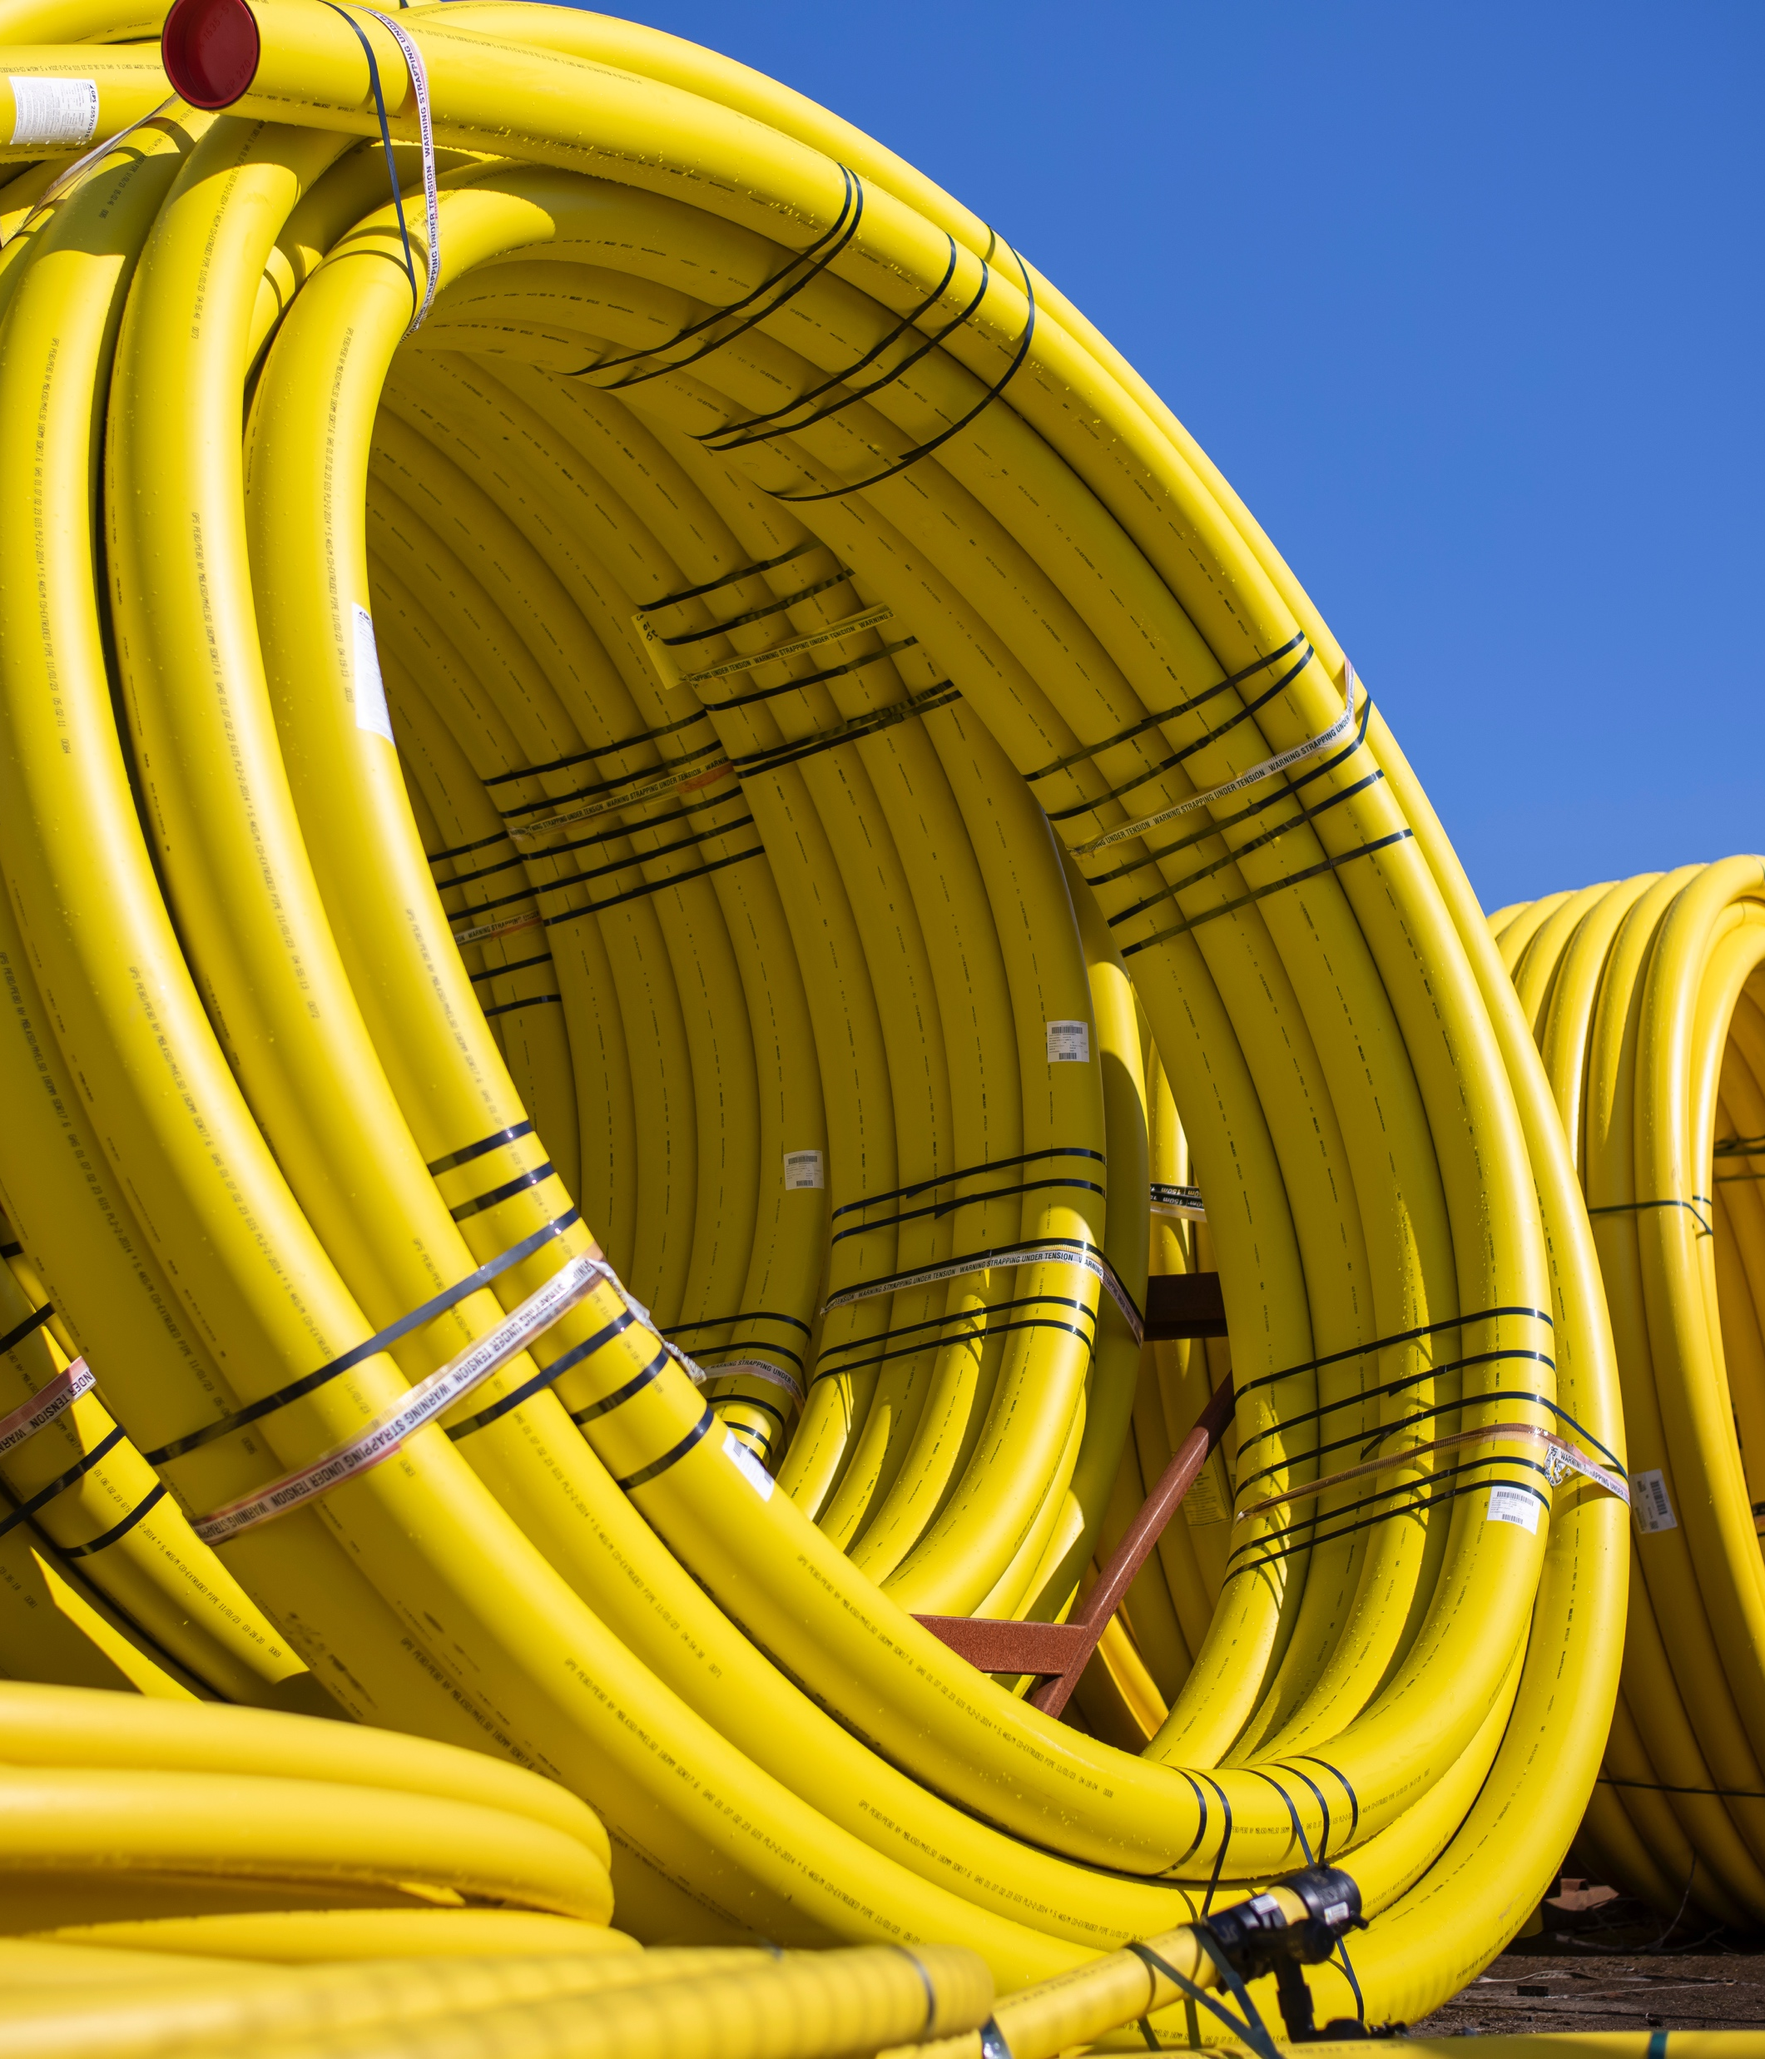
However, businesses are unwilling to incur higher bills as a result of quicker work
I think I’d rather it take a while and be communicated with than have to pay for it to be done quickly. At least if I know it’s happening I can plan for it. If they turn up out of the blue and work on something really quickly it might actually impede my trade more than if it took longer and I knew about it.
We asked panelists in the committee meeting to consider their willingness to pay for faster work through an increase in their bills.
Business owners do not consider this an option in the current context of rising business expenses.
Instead, they consider clear and timely communication a good compromise and a way of mitigating the effects of disruption to their business, bringing a sense of predictability which allows businesses to plan against potential lost profits.
Furthermore, business customers view the pipe replacement programme as essential to WWU’s work to become more sustainable, and feel the business should be absorbing at least some of the costs as part of their commitment to sustainability goals.
As long as we are informed as early as possible I think that would be fine so we can put necessary procedures in place.
If this is about the sustainability of their operations then some additional costs should be absorbed by the supplier.

Slide 19
WWU’s emergency service

Slide 20
Business customers find responding to uncontrolled gas escapes important but know little about gas emergencies overall
Business owners find responding to uncontrolled gas escapes the most important part of WWUs’ emergency service. However, they know little of what to do in an emergency themselves.
There is not one go-to phone number business owners would call in a gas emergency. The panel is split between calling their gas supplier, their distributor (WWU) or the National Gas Emergency Service. A handful of business owners explain that they would call the emergency services.
Business owners expect that whoever they speak to would be easy to contact and respond immediately over the phone, providing them with a timeframe of when the issue would be solved. They expect the situation to be dealt with as quickly as possible given how dangerous a gas emergency may be.
Now that I know, I would contact Wales & West Utilities! Before, though, my first point of contact would've been my supplier.
Q: Thinking about what you have learnt about Wales and West Utilities' emergency service, what is most important to you? N= 28

Slide 21
Overall, the panel is comfortable with emergency response times
Please review the statement below: 'We should respond to an uncontrolled escape within 1 hour; this is the regulatory requirement.' Please rate how comfortable you are with a 1-hour response time:*
Business customers are pleased to see that WWU are exceeding their target of responding to 97% of uncontrolled gas escapes in less than an hour.
While a significant minority report being uncomfortable with this given the dangers associated with an uncontrolled gas leak, they caveat this with the understanding that it feels unrealistic to be able to respond to all escapes this quickly, particularly given the size and rurality of the area that WWU cover, and they trust WWU to assess the risk appropriately.
Information about gas escapes feels abstract and it’s hard to know what would be harmful or dangerous to the public.
Whilst business customers agree the record for responding to gas leaks is good, some panel members want more context. For example, some see this as impressive considering the rural nature of some of the area. However, others feel that without knowing the total number of escapes it is hard to know exactly what this means.
I think 1 hour is acceptable and stats show they are hitting this objective.
Q: We would now like to find out more about what you think about Wales and West Utilities' response times in the event of an emergency. Please review the statement below: 'We should respond to an uncontrolled escape within 1 hour; this is the regulatory requirement.' Please rate how comfortable you are with a 1 hour response time n=28, (excludes ‘don’t know’)
* See appendix for full poll results

Slide 22
However, they have mixed views towards repairs
The panel have mixed comfort levels with not all repairs being carried out immediately.
However, there is an understanding that not all gas escapes are urgent, and overall customers trust WWUs’ judgement on what needs to be prioritised.
I understand that there is controlled and uncontrolled but I feel gas leaks should be dealt with immediately.
I'm sure that they would repair all gas leaks that are repairable immediately, immediately. Obviously, there will be some that aren't immediately repairable but that would be made safe.
Q: How comfortable are you that Wales & West Utilities don’t repair all gas escapes immediately? n=28

Slide 23
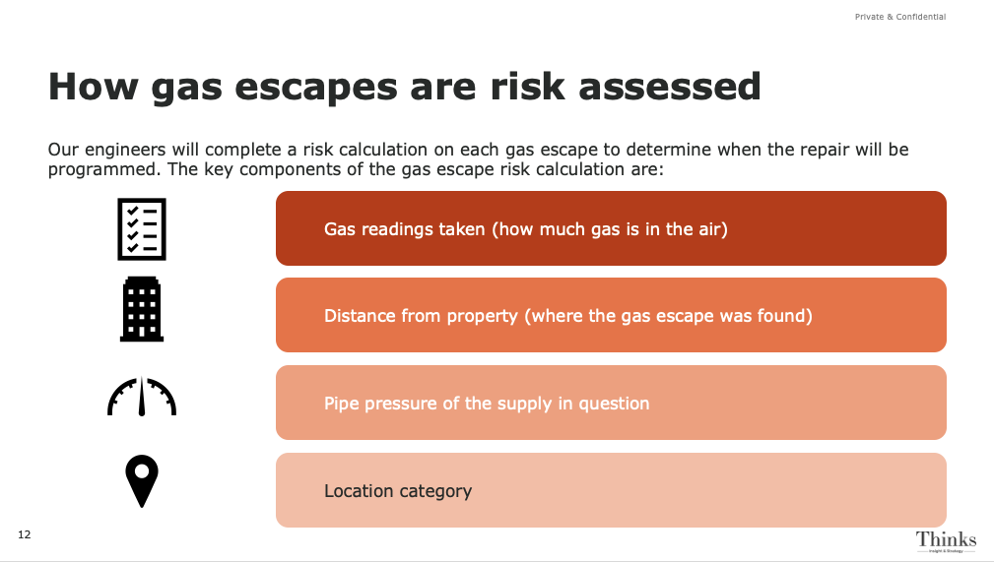
It is hard for business customers to understand how risks should be assessed
Business customers were shown a summary of how WWU assess the risk associated with each gas escape. They feel that without specialist knowledge it is difficult to understand whether it is comprehensive or not. However, they do expect the following points to be included in any gas escape risk assessment:
    The total population of the area
    Risk to life assessment
    Risk of ignition assessment

Slide 24
Priorities

Slide 25



Business customers have mixed views on the best time for WWU to carry out essential works
Some customers suggest night-time as the best time to carry out essential work on the assumption that this would cause less disruption to businesses. However, this would have to be considered against:
The level of noise the work might generate
The urgency of the work regarding safety and supply
  The make up of the area, for example residential/business, bars/office buildings
Throughout the night would make the most sense as that is when there are less cars on the road. It won’t disrupt people going about their daily tasks such as getting to and from work or school or affect businesses so much.
I’d prefer the work to be carried out during the day as our bar is open from late afternoon until the early hours so this would have less of an impact on our customer being able to visit.
  Business customers also suggest consulting with businesses in the area while work is planned to understand the preferences of those who would be affected.

Slide 26
Recommendations

Slide 27
Business customers value communication for the smooth running of their business
What to communicate
How
Why
Planned maintenance and other essential works
Communicate well in advance – at least a month
Include information on what disruption business owners can expect and how long it will take
Update regularly on progress
Consider consulting business customers on the best times for work to take place
Consider communicating how work is planned to avoid bill increases
Business customers need to know exactly how long work will take and what disruption it will cause to put essential plans in place for their business
Knowing that they have been consulted in the process will give them a more positive attitude towards the situation
What to do in a gas emergency
Proactively educate customers by communicating essential information such as the gas emergency helpline prominently on customer bills, and what to expect when customers call it
Business customers have low knowledge on what to do in the event of a gas emergency
Gas safety
Educate customers about different types of gas leaks and how to determine levels of danger
Consider doing this by putting numbers into an understandable context, and where possible eliminating numbers all together
Business customers are confused by information on different types of gas leaks but think it is essential to understand to be more gas safe
Sustainability
Communicate the sustainable credentials and objectives in any new business plans and maintenance
Customers are increasingly becoming more sustainability aware and are keen to know how the businesses they are involved with are taking steps to make their operations more sustainable.

Slide 28

Thank you
hello@thinksinsight.com
T: +44 (0)20 7845 5880
www.thinksinsight.com
Thinks Insight & Strategy
West Wing
Somerset House
London
WC2R 1LA
United Kingdom
For more information on this report, contact:
Andy Barker | abarker@thinksinsight.com
Teresa Kuhn | tkuhn@thinksinsight.com
Katie Spittle | kspittle@thinksinsight.com
Jowan Taylor | jtaylor@thinksinsight.com

