Slide 1
Wales & West Utilities
Stakeholder Workshop
Cornwall

Slide 2


Housekeeping

Slide 3

Welcome
Introduction | 09:30 – 10.00
Session 1: Introduction – Reflecting Stakeholder Views In Our Business Plan | 10.00 – 10.10
Session 2: Your Priorities & Value For Money – Stakeholder & Customer Priorities & Our Bill Explained | 10.10 – 11:05
Session 3: Mains Replacement & Theft Of Gas – Our Mains Replacement Process & Tackling Theft Of Gas | 11:05 – 11.45
Coffee Break | 11.45 – 12:05
Session 4: Future Of Energy – Taking part in the conversation | 12.05 – 12:35
Session 5: Social Obligations – Safeguarding Plan Now & In The Future | 12:35 – 13:10
Summary & Close | 13.10 – 13.20
Lunch | 13.20 – 14.00
Optional Surgery Sessions
· Sustainability – honing our goals | 14.00 – 15.00
· Social obligations – Working Together training session
· Streetworks– Our current and future plans
Notes:
Note: No fire alarms planned, assembly point… etc

Slide 4
INTRODUCTION

Slide 5
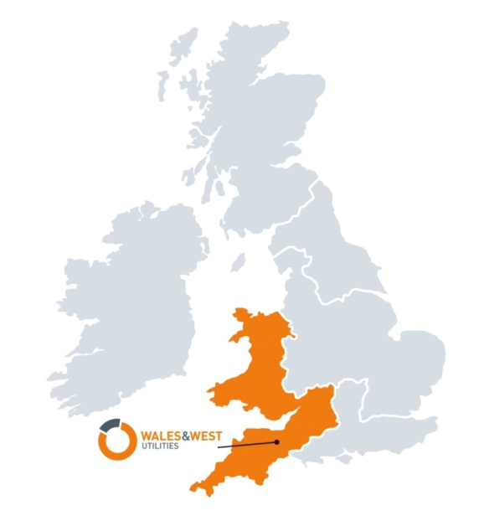


Wales & West Utilities
We don’t sell gas; we transport it through our 35,000km network of pipes
We invest £2m a week connecting new homes & businesses to our gas network & upgrading old metal pipes to new plastic ones
We employ more than 1600 people & have a contract workforce of around 500
We keep 7.5m people safe and warm – with levels of service, safety and reliability they can trust
We respond to more than 80,000 gas emergencies a year
We are the gas emergency and pipeline service for Wales and the south west of England
We are regulated by Ofgem
We are a values-driven business – safety is our number one priority and our customers at the heart of everything we do
Notes:
Overview of who we are and what we do, for those who aren’t aware
This slide is self explanatory along with a little bit more history around how we have moved on from being British Gas
Wales & West Utilities (WWU) began operations on 1 June 2005 after the gas distribution network was sold by National Grid. We’re a regulated business, operating around 35,000 kilometres of gas pipelines, serving 2.5 million homes and businesses across Wales and the South West of England and we provide the Gas Emergency Service. Etc…..
Gas distribution network (GDN) that transports gas to homes and businesses across the whole of Wales and the south west of England.
Regulated by Ofgem (Office of Gas and Electricity Market).
Head Office in Newport, South Wales, Deploying circa 2,000 people across Wales & the South West of England including contractors
In 2012 we became a part of the Cheung Kong Infrastructure Family (CKI). They are a leading player in global arena with diversified investments in:
Energy Infrastructure
Transportation Infrastructure
Water Infrastructure; and
Waste Management
Brief description of operations :
Build & Replace Teams
Carry out all repairs to our network gas mains and services and complete all new customer connections work. They also help with the delivery of our Replacement and Capital programmes, to make sure that we can supply all future gas demand across Wales and the South West From Colwyn bay to Penzance. They also provide logistical support, by keeping our teams supplied with materials for job completion and reinstatement.
Emergency Metering Services Teams
Will deal with all aspects of emergency and metering activities, both regulated and unregulated. Our First Call Operatives (FCOs) carry out around 80,000 metering jobs for NGM each year, making a significant contribution to our company’s unregulated income. All of our FCOs are gas safe registered, and carry out a range of services including:
attending reported escapes
installing and repairing pipework
resetting, repairing and replacing gas meters
carrying out checks for safety, and
reconnecting customers after service relay or mains work.
Network Services
Carry out the maintenance, construction and protection of above and below ground natural gas assets, this is critical to the safe supply of gas to customers in Wales and the South West of England. Within our company, a dedicated team of Staff, Industrial Staff and Contractors undertake this work and also provide a round the clock fault and emergency response service.
Another key element of the Above Ground workload is the provision of maintenance services to National Grid Metering, National Grid Transmission and other large gas consumers. These fully commercial contracts provide valuable non formula income to WWU and the Above Ground Team are committed to delivering a high quality service to these important customers.
Operations Health, Safety and Environment (HSE)
The HSE team supports our company’s ‘Demanding Safety Always’ priority - making sure that our workforce can work safely, and promoting good health and wellbeing.
In addition, we make sure that our process safety operations don’t negatively impact on the environment, or our excellent reputation for operating a safe and reliable gas network. We have a team of HSE professionals that will strive to improve Our Operations HSE Performance by:
introducing compliance guidance, based on changes to legislation
monitoring performance against set targets
carry out inspections/audits and feedback on performance
promote initiatives to help us deliver performance improvement
identify priorities based on Operational risk
produce and deliver an annual Operational HS&E Improvement Plan
influence the culture of the operational workforce by promoting health and wellbeing
helping to deliver the Ofgem Safety Outputs and Company Safety targets
Other areas of the business that also provide a vital service to both our internal and external customers
Health Safety & wellbeing
HR Inc.… corporate affairs and external relations
Finance
Business services Inc.… IT
Asset

Slide 6
Purpose for today
Understand your priorities
Seek feedback on our Business Plan
Your thoughts on current activities?

Slide 7
DISCUSSION SESSION

Slide 8
Session 1
Our business plan &
Your priorities
Sarah Williams – Head of Regulation

Slide 9
What is RIIO – GD1?
Ofgem- Office of Gas and Electricity Markets
We are regulated by Ofgem who set our prices and targets with the consumers best interests in mind.
=
Revenue=
Incentives+
Innovation+
Outputs
Is the framework that sets the outputs the 8 gas distribution networks (GDN’s) need to deliver for consumers – it also sets our charges for 2013-2021
=
GD1 – Gas Distribution 1
Is the control period from 2013-2021
=
!
RIIO-GD1 is the first gas distribution price control review to use the RIIO model.
Notes:
Explain the concept of being a regulated monopoly
Our customers can’t vote with their feet

Slide 10
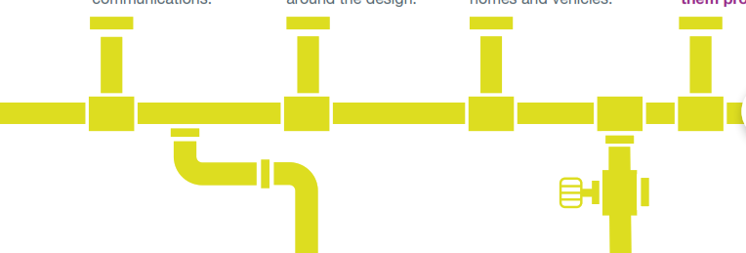
What is RIIO - GD2?
GD2 – Gas Distribution 2
=
Is the control period starting in April 2021
RIIO-2 will be the next price controls for the network companies running the gas and electricity transmission and distribution networks.
RIIO is designed to: encourage networks to
!
Innovate to reduce network costs for current and future consumers.
Invest efficiently to ensure continued safe and reliable services.
Play a full role in delivering a low carbon economy and wider environmental objectives
Put stakeholders at the heart of their decision-making process

Slide 11

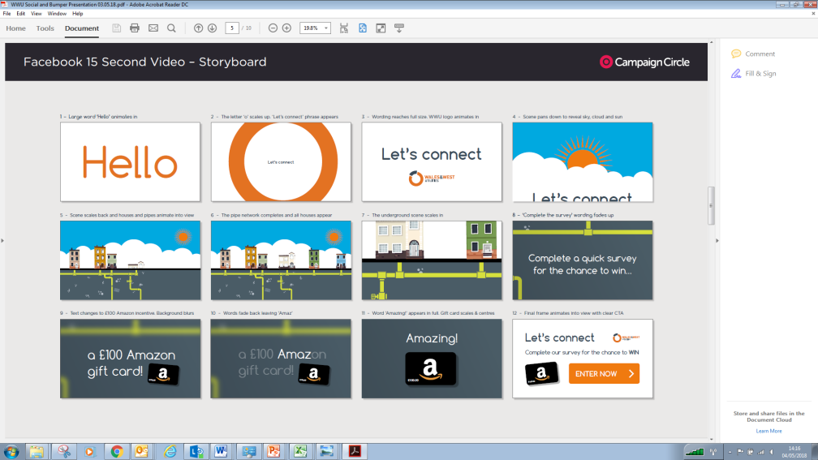

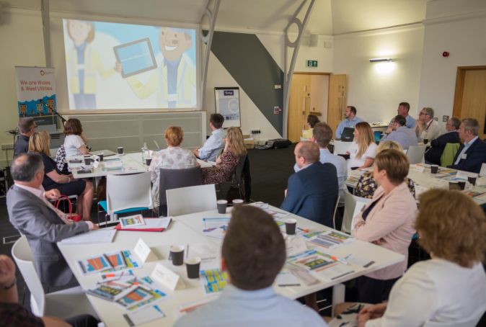
Our GD2 engagement
To prepare for GD2, we have engaged with customers and stakeholders on what’s important to them
Their feedback has helped to shape our GD2 Business Plan
Facebook Chatbot
Web Portal
Events
Workshops
Qualitative
WEIGHTING
Quantitative

Slide 12
Engagement & research
Wide ranging engagement programme – incorporating our Business as Usual activities, ‘deep dives’ on specialist topics and a wider consumer campaign
  New Customer Engagement Group in place since September 2018
Let’s Connect – got more than 21,000 customers involved
We then analysed the responses and looked at more targeted engagement
  Co-created survey of more than 1,000 consumers and SME’s
  Five ‘deep dive’ topics
    Sustainability
    Future of Energy
    Innovation
    Asset Management and risk
    Vulnerability
Supported by specialise research agencies Impact Research and Mindset
Collaborative engagement for strategic and national stakeholders

Slide 13
Some key findings
Safety and reliability are of key importance to all stakeholders
  Investment in our replacement programme should be a priority in support of this
  Maintaining (not improving) our extremely high safety standards
  A focus on multi occupancy buildings following the Grenfell Fire
Support for environmental issues is an emerging theme
  Concern over escaping gas and its CO2 impact
  A push from our new CEG on Sustainability
Strong support for our work with vulnerable customers
  Priority Services Register
  Making existing services more accessible, not doing more
  Emerging theme of ‘emotional vulnerability’ and anxiety
Generally satisfied with our customer performance and no desire for us to do more

Slide 14
Stakeholder Priorities

Slide 15
Stakeholder priorities over the years
2017/18
CO awareness and prevention =
Customers in vulnerable situations +5
Lower carbon future -1
Supporting those in fuel poverty =
Meeting future demand =
Innovation +2
Customer service NEW
Connections NEW
Theft of gas -6
Major incident planning -4
Protecting the environment -2
Smart metering -2
2016/17
CO awareness and prevention
Lower carbon future
Theft of gas
Supporting the fuel poor
Meeting future demand
Major incident planning
Customers in vulnerable situations
Innovation
Protecting the environment
Smart metering
Notes:
CO awareness and prevention always comes out on top
Vulnerable and fuel poor customers has risen over the years, and are now at the top
Smart metering has been consistently low – so we are removing it from the priorities this year
Theft of gas has decreased in importance
Low carbon future has actually decreased to fourth place since 2016 and protecting the environment has been low, although it went up two places last year
We’ve added new priorities e.g. customer service, connections. This year we are adding cyber security

Slide 16
Stakeholder priorities and findings
2018/19
CO awareness and prevention =
Customers in vulnerable situations =
Supporting those in fuel poverty +1
Lower carbon future -1
Meeting future demand =
Innovation =
Customer service +1
8. Connections =
Protecting the environment +2
Major incident planning =
Theft of gas -2
Smart metering = Remove
Notes:
At our 2018 Regional Workshops, stakeholders were asked to re-vote on our priorities. The final result is as follows,
It was noted that priorities were difficult to rank against each other.
The suggestion to remove smart metering was made given it is a supplier led roll out
An electricity supplier suggested cyber security should be on the list as a new priority

Slide 17
Mini breakout session
2018/19
CO awareness and prevention =
Customers in vulnerable situations =
Supporting those in fuel poverty +1
Lower carbon future -1
Meeting future demand =
Innovation =
Customer service +1
8. Connections =
Protecting the environment +2
Major incident planning =
Theft of gas -2
Smart metering = Remove?
What do you think our stakeholder priorities should be for 2019/20?

Slide 18
Session 2
VALUE FOR MONEY
Sarah Williams – Head of Regulation

Slide 19
Value for money

Slide 20

Gas vs electricity
One unit of electricity from the mains (measured in kWh) will cost you about 15p/kWh.
To buy one unit of mains gas (measured in kWh) you will pay about 4p / kWh.
Domestic gas prices, including VAT, fell by 1.6% between March 2018 and March 2019
Domestic electricity prices, rose by 3.9% between March 2018 and March 2019
This means that gas is about 3-4 times cheaper than electricity per kWh.
Notes:
https://www.thegreenage.co.uk/cheaper-heat-home-gas-electricity/

Slide 21
The average annual gas bill
Our charges make up 19% = £121 the equivalent of 32p a day
This goes direct to your gas supplier
Our charges have reduced from £145 from 2013

Slide 22
Delivering value for money
Domestic electricity prices, rose by 3.9% between March 2018 and March 2019
While domestic gas prices, including VAT, fell by 1.6% over the same period
2018/19 Bill split
Notes:
https://www.gov.uk/government/statistical-data-sets/monthly-domestic-energy-price-stastics

Slide 23
How are our costs made up?
Operational
Replacement Expenditure = Replacement of metallic mains with plastic
Operating Expenditure = Attending gas escapes, repairs, maintenance, training, support activities, insurance
£80m
£70m
Planning for the future
£51m
Capital Expenditure = Money spent on assets; gas network, vehicles, IT, plant & equipment
2018/19 Years prices

Slide 24
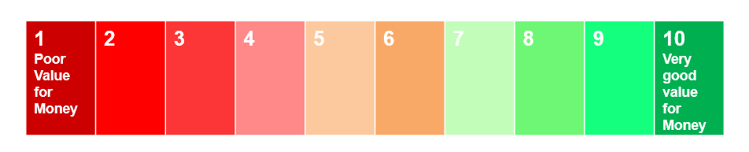
Discussion session
The average gas bill is £650 and our charges make up 19% just over 32p per day do you think this is:
Why?

Slide 25
DISCUSSION SESSION

Slide 26
Session 3 safety: Our mains replacement and theft of gas
Sarah Williams – Head of Regulation

Slide 27
Mains replacement

Slide 28
Context
We have 32,000km of pipes which we monitor and maintain
Driven by the HSE.
Replaces old metal leaking pipes with plastic ones
REPEX (Mains Replacement Programme)
71% of our gas pipes are plastic. By 2026, 81% will be plastic.
Replace >435km of pipe pa.
Replace all metallic pipes 30m from a building by 2032 (30:30 programme)

Slide 29
Why do we do it?
The benefits are….
Reducing risk of explosion (our current programme will reduce risk of explosion to 1 in 15 years)
Reducing emissions (currently accounts for 96% of WWUs carbon emissions)
Planned interruptions rather than unplanned
Connecting new forms of green gas to the grid
Offsetting the costs of increasing repairs as the mains get older
Safety
Environment
Disruption
Future-
proofing
Cost

Slide 30
Why are costs going up?
The cost of labour is increasing
Less opportunity to use low cost techniques (insertion being replaced by open cut)
The larger (therefore more cost effective) projects have already been carried out
To maintain our current approach in GD2 would require a higher level of investment

Slide 31
Topic for discussion
Customers were willing to pay £2.22 to replace old leaking metal pipes with long lasting plastic ones to reduce our carbon emissions
Which option would you like to see for our mains replacement programme and why?
Option | Cost movement | Bill impact (Currently 82p) | Gas mains replaced | Safety impact | Environmental impact | Disruption impact
1 | Same as today | No impact | 395km compared to 435km today | Reducing risk of an explosion to 1 in 13 years | 1.7% reduction per annum of gas leaking to atmosphere | More unplanned work and interruptions
2 | 10% increase | + 8p per annum | 435km, Same as today | Reducing risk of an explosion to 1 in 15 years | 2% reduction per annum of gas leaking to atmosphere | Same as today
3 | 20% increase | + 16p per annum | 484km compared to 435km today | Reducing risk of an explosion to 1 in 16 years | 2.2% reduction per annum of gas leaking to atmosphere | More planned work and interruptions

Slide 32
Communicating our planned works

Slide 33
How we communicate with stakeholders
Local Authorities : 3 months notice
Planner sends notice to council on high profile projects
Businesses
More notice is given on the pre-notice initial letter
Major notice to council is issued
If the project is traffic sensitive there will be a site visit with the programme controller where traffic management is discussed
Come to agreement with councils at HAUC meeting – negotiate if needed
Customer Support Officers' visit to discuss plans etc.
More FLM involvement to consider the location and practicality of the work

Slide 34
How we communicate with customers
GSOP 13 Letter
Sent at least 5 working days ahead of works – notification of interruption sent to household
Customer Support Officers
Door-knocks after letter lands: takes contact number, provides point of contact and identifies any vulnerable customers
Team deployed to site
Households provided with expected interruption date (often different from letter).
Last Notice
Team provides at least 24 - 48 hours notice before turning off supply
There are concerns around the notice period we give customers and the lack of clarity on the date of works
There is a specific concern for the communication for customers in vulnerable situations

Slide 35
Our Future Proposal
GSOP 13 Letter
Sent at least 5 working days ahead of works
Customer Support Officers
Door-knocks after letter lands
Team deployed to site
Expected interruption date given
Last Notice
24 - 48 hours notice before turning off supply given
Pre-GSOP 13 Letter
Sent 3 months before – outlining the anticipated work
New
Existing

Slide 36
Future proposals discussion
What are your thoughts on this?
How far in advance would you like to receive notice?
What type of information should we include in our letter?
Send pre-GSOP 13 letter 3 months in advance to address concerns around anxiety and dissatisfaction of our current comms

Slide 37
THEFT OF GAS

Slide 38
Background
Meter Point Reference Numbers (MPRNs) enable us to bill customers
Gas theft increases costs for customers
Interfering with gas meters or pipes is also a serious risk to safety
Our Connections team manage the creation of new MPRNs
Some consumers illegally connect onto existing services and use ‘dummy’ meters – this is known as theft of gas
Ofgem require us to play an active role in detecting, investigating and preventing the theft of gas

Slide 39
Theft of gas – the facts
The energy industry has estimated that a whopping £400 million worth of gas and electricity is stolen every year in the UK,
Theft of gas means tampering with the meter so it doesn’t record how much gas is being used or trying to bypass the meter completely.
Theft of gas is a common crime, taking place on high streets, in homes and businesses all around the country – and you may be an unwitting victim of gas theft.
a loss that adds around £20 to the customer’s bill. More than 15,000 cases are investigated every year.
Recorded incidents of fires and gas explosions, causing massive injuries, damage to homes and property, and in some cases, loss of life.
Notes:
https://www.stayenergysafe.co.uk/resources/gas-meter-fraud-the-facts/

Slide 40
How are we tackling it?
We have undertaken trials to identify sites with live MPRNs, meters and no registered supplier
We have increased the amount we recover annually from less than £250k to over £500k

Slide 41
Bespoke incentive for GD2
Takes time and money: time to follow up cases, send letters, do visits etc.
Proposing a bespoke output in RIIO GD2 to allow us to be incentivised to do more proactive work
Allows us to keep 50% of the money recovered above £250k plus costs incurred
50% going back to customers through their supplier
Customers are not paying for lost gas at that property going forward.

Slide 42
Tackling theft of gas
Customer bill impact 2p per annum
Would you support our request to incentivise us to do more proactive work to tackle theft of gas?

Slide 43
DISCUSSION SESSION

Slide 44

Coffee break

Slide 45
Topic for discussion
Customers were willing to pay £2.22 to replace old leaking metal pipes with long lasting plastic ones to reduce our carbon emissions
Which option would you like to see for our mains replacement programme and why?
Option | Cost movement | Bill impact – currently 82p | Gas mains replaced | Safety impact | Environmental impact | Disruption impact
1 | Same as today | No impact | 395km compared to 435km today | Reducing risk of an explosion to 1 in 13 years | 1.7% reduction per annum of gas leaking to atmosphere | More unplanned work and interruptions
2 | 10% increase | + 15p per annum | 435km, Same as today | Reducing risk of an explosion to 1 in 15 years | 2% reduction per annum of gas leaking to atmosphere | Same as today
3 | 20% increase | + 30p per annum | 484km compared to 435km today | Reducing risk of an explosion to 1 in 16 years | 2.2% reduction per annum of gas leaking to atmosphere | More planned work and interruptions

Slide 46
Session 4
Future Energy Solutions
Sarah Williams – Head of Regulation

Slide 47
The current role of gas
85% of homes use gas for heating
This is mainly because gas is 75% cheaper than electricity to heat homes
UK government commitment to reduce emissions by 80% by 2050
180,000 homes in Wales & West Utilities’ area are served by green gas so far
We have 19 biomethane plants providing 3 x the energy of the Swansea Bay Tidal Lagoon
Green gas is an essential part of the energy mix; least disruptive and lowest cost
Notes:
The cost of renewable energy is socialised – you already pay for this in your energy bills.
Previously power stations were powered by coal, but we are no longer able to use coal to produce energy by 2025
Two energy sources – electricity and gas – student tower blocks mostly electricity. Heat is delivered by gas, electricity is generated in many ways, nuclear, renewables and gas fired power stations generating electricity
We still aren’t meeting the carbon reduction criteria yet

Slide 48
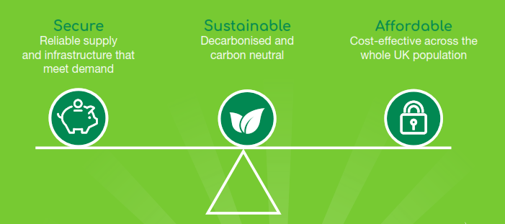
Finding a balance
Legislation
Climate Change Act
UK Carbon Reduction Targets - 80% reduction by 2050
5yr Carbon Budgets
2023 – 2027 - 51% reduction by 2025
Notes:
Government legislation requires the UK to reduce carbon emissions by 80% by 2050 with a 51% reduction rate by 2025
When weighing up the pros and cons of
different energy solutions, it’s important
to consider three things: how reliable it
is; the environmental impact it has; and
how much it costs. Some solutions might
be very sustainable, but cost a lot and
are unreliable. Others might be cheaper
and reliable, but less sustainable.

Slide 49
Role of gas – in the future
UK Government looking at multiple pathways to decarbonise heat no ‘silver bullet’
Hydrogen is a promising way to heat major cities & decarbonise heat by 30%
We forecast
New build homes still forecast to use gas during GD2 c.10,000 pa
Increased demand from more gas fired power stations who connect to support intermittent renewable electricity
642,000 homes in Wales & West Utilities’ area forecast to be served by green gas in GD2
20 new biomethane plants to connect to Wales & West Utilities’ network in GD2
This will cost consumers 83p per year by 2026
We need to invest £13m per year to support this move to green gas

Slide 50
Role of gas to support green electricity
Around 30% of UK electricity is from renewable sources
When the sun isn’t shining or the wind isn’t blowing – small gas fired generators provide our electricity
More gas fired power stations will be needed in GD2 to support more intermittent renewable electricity
Storing energy for use when it is needed is essential – the gas network offers this
Using Batteries to store energy would cost UK £1.65 trillion
We need to invest £2m per year to support renewable electricity
This will cost consumers 7p per year by 2026

Slide 51

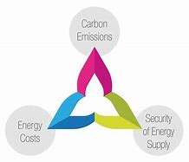
Fuel of choice – questions
Do you think we should spend more in order to encourage more green gas to enter our network?
Do you think we should spend more to support the greening of the electricity network?
Who do you think should pay for this investment? Government? Developers? Gas Consumers?
Notes:
Developers – it would impact the viability of green gas development

Slide 52
Session 5
Social Obligations
Nigel Winnan – Customer & Social Obligations Manager

Slide 53
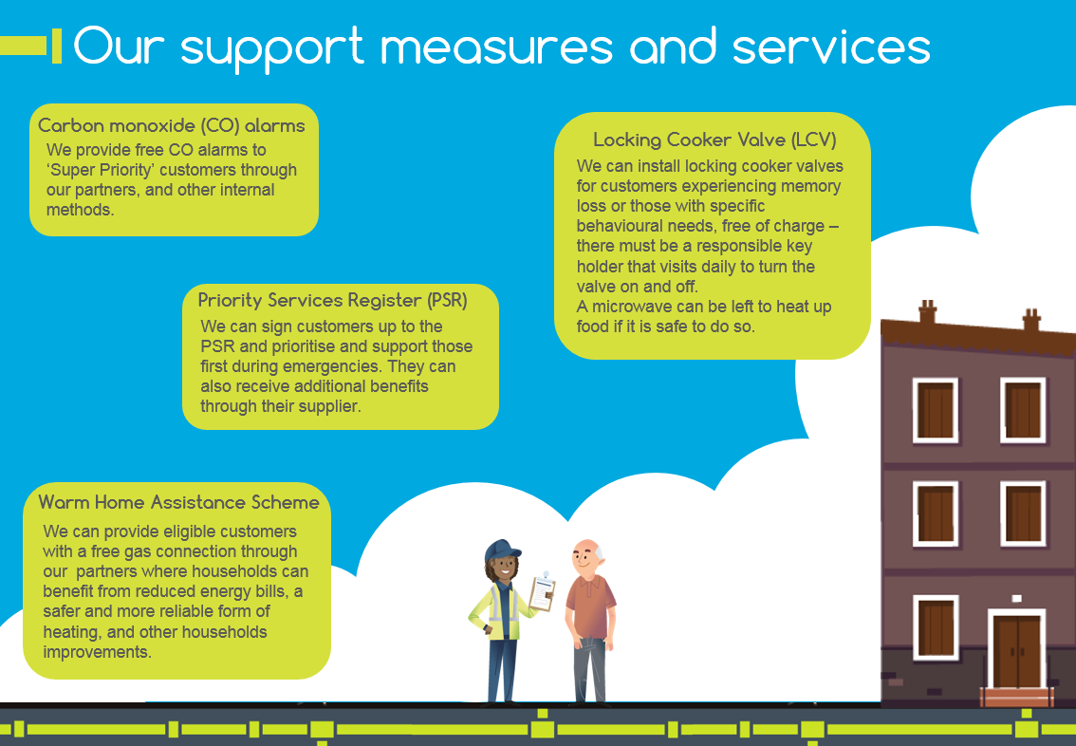

Slide 54



Outcomes in GD1 – Customers in vulnerable situations
Achieved British Standard for Inclusive Service Provision, verified again in 2017/18 for the whole business.
Registered more than 4,000 customers for the Priority Services Register in 2017-18 - 56% more than the previous year
Invested £80,000 to move gas meters that couldn’t be easily accessed - free of charge to those in need

Slide 55


Outcomes in GD1 - Carbon Monoxide (CO)
We work with 6 Fire & Rescue Services, Care & Repair, and others to reach our priority customers
Provided more than 4,500 CO alarms free of charge in 2017/18 to our highest priority customers, at a cost of more than £59,000
Recruited 21 colleague Gas Safety Ambassadors – and delivered safety messages to more than 1,500

Slide 56
Our research told us
Low awareness of the PSR
Targeted social media programme – 4,227 customers registered for the PSR in 2018/19, 20% increase on last year
Emotional vulnerability
Incorporated into our safeguarding training. 170 colleagues received this training
Anxiety around disruption
Provide regular communication through cards, letters & face to face engagement with our CSO’s to keep customers up to date with our work
Addressing individuals needs
Re-trained 50 key partner home safety workers
Attended community events to promote the PSR and other support measures
REPEX boards introduced with information for customers to contact & address concerns
More than £4800 of our hardship fund was utilised across 23 individual cases
Our Community Energy Champions have saved 1150 customers more than £800k in 2018/19
New customer development package to be launched later in 2019
Notes:
We carried out research into the type of issues customers in vulnerable situations face and how our support measures and services are perceived – we engaged with carers, general consumers, vulnerable consumers and case workers to determine how we can better serve our customers in the most vulnerable situations
Mindset Findings
Individuals in potentially vulnerable situations and circumstances do not generally know about the provisions in place to support priority customers. This lack of awareness extends to the PSR.
Self-evidently, to support vulnerable individuals, WWU needs to be able to identify them and, on the basis of this research, a top priority must be raising the profile of the PSR
Emotional vulnerability – often linked to other more visible and tangible vulnerabilities – is a key theme. Customers suffering from often complex physical and circumstantial vulnerabilities tend to be more susceptible to emotional vulnerability and anxiety.
Anxiety about the prospect of disruption (due to planned or emergency WWU work) is as important an issue to address as vulnerabilities relating to the work itself. It is therefore critical that communications ahead of, during (and even after) WWU work are carefully planned and managed.
Lack of awareness on the PSR : We’ve developed a targeted social media programme to raise the profile of our online sign up form that enables access to further support if needed. We’ve also re-trained all our partners on the PSR, we’ve received 244 referrals from our partners in March following our training. We’ve attended numerous community events to raise the profile of our support measures and engage with individuals and VC experts on the support we can offer.
Emotional Vulnerability – incorporated into our safeguarding training delivered to 170 customer facing colleagues
Anxiety around disruption – Provide regular communication through cards and letters accompanied with face to face engagement by our CSO’s to keep customers up to date with our work. Introduced REPEX boards that provides the local scheme manager and Customer Support Officers contact information for customers to contact & address any concerns or ask any questions they may have about the work
Addressing individuals needs - Our hardship fund is assess on a case-by-case basis depending on the individuals circumstances. More thn £4800 of our hardship fund was utilised across 23 individual cases

Slide 57
Perceived value - Customers
Customers were willing to pay…
47p to increase the services offered to support customers in vulnerable situations
26p to raise awareness of the risks of CO poisoning
20p to provide funded gas connections to customers in fuel poverty & low income households
Social obligations/supporting customers in vulnerable situations was placed ahead of general customer service.
Notes:
Our research into the importance of our business areas with customers revealed that customers placed Social obligations/supporting customers in vulnerable situations was placed ahead of general customers service.

Slide 58
Our strategy for GD2
Expand our works to raise the profile of the PSR & increase sign ups - work towards a common PSR across the utilities
Focus CO awareness and provision of free monitors on the most vulnerable customers and educate future generations
Provide support to customers to improve energy efficiency, and lift homes out of fuel poverty & continue to deliver funded gas connections to fuel poor homes
Use a new tool to assess the wider ‘Social Return on Investment’ to prove the wider value of our support for the vulnerable and of our SOs

Slide 59
Community fund
2018 Regional Workshop Stakeholder Feedback: “Consider developing a trust fund for partners to use to fund social obligation needs”
Included in our business plan is the prospect of us offering a pot of £50k to fund community projects to help promote gas safety and vulnerable customer support to the hard to reach
What do you think the framework around this would be?
What should the criteria be?
Should we consider other factors like seasonality, demographics, region?
The impact on the bill is est. 6p
Notes:
At our 2018 Regional Workshop, we received Stakeholder Feedback around Considering the development of a trust fund for partners to use to fund social obligation needs.
We’ve included this in our business plan and have proposed a fund of £50k for community organisations to apply in order to fund community projects
We want to know what stakeholders think of this idea,

Slide 60


Our Social Return On Investment Tool
Social Return on Investment (SROI) is an outcomes-based measurement tool to understand and quantify non-financial values of activities and investments
An SROI analysis takes Cabinet Office data and metrics and our stakeholder feedback to help us to work out what out customers want - giving us a picture social and customer benefits with a ratio that states how much social value (in £) is created for every £1 of investment

Slide 61
Vulnerability incentive
Which option for GD2 would you opt for?
1
2
 | GD1 | GD2 Option 1 | GD2 Option 2
Co monitors issued | 6,500 p.a | 10,000 p.a | 15,000 p.a
PSR sign ups | 3,600 p.a (since 2016) | 9,000 p.a | 15,000 p.a.
school events | 40 | 50 | 200
families helped | 850 / £500k | 1,700 / £775k | 2,200 / £1m
locking cooker valves fitted | 40 | 50 | 50
community project fund | N/A | £50k pa | £100k p.a
Total spend | £510k p.a | £750k p.a. | £1.25m p.a
Bill impact (estimated) | 20p pa | 30p pa | 50p pa
Total GD2 investment (inc FPNES) | £4m | £3.75 | £6.25m
Customer fincial benefits in GD2 |  | £10.2m | £17m
Total GD2 social return | n/a | £8.9m | £14.5m

Slide 62
DISCUSSION SESSION

Slide 63
Summary

Slide 64
What we’ve captured today
Your priorities
Your investment focus for GD2
Your communication needs around our planned work
Your views on our Ofgem funding requests
Ownership of investment around green gas and greening electricity

Slide 65
Would you now change anything?
2018/19
CO awareness and prevention =
Customers in vulnerable situations =
Supporting those in fuel poverty +1
Lower carbon future -1
Meeting future demand =
Innovation =
Customer service +1
8. Connections =
Protecting the environment +2
Major incident planning =
Theft of gas -2
Smart metering = Remove?
What do you think our stakeholder priorities should be for 2019/20?

Slide 66
Would you now change anything ?
The average gas bill is £650 and our charges make up 19% just over 32p per day do you think this is:

Slide 67
DISCUSSION SESSION

Slide 68
Next steps
We will share the slides with you electronically
If you request the slides in another format or language please let us know
If you know someone that would like to receive our update that couldn’t make our workshop please let us know
Once our report is drafted we will circulate this to you
If you’d like to come to a future workshop please let us know

Slide 69
Up Next
First…Lunch!
Then at 2pm we have the following surgeries:
Sustainability – honing our goals
Social Obligations – our support measures and service
Street works – our current and future plans

