Slide 1

Wales & West Utilities | Citizens’ Panel Research: Supporting customers in vulnerable situations
Final report | August 2023

Slide 2
Contents
01
03
05
07
Background and methodology
02
WWU’s vulnerability services
04
Working with partners
06
Appendix
Key findings
Responses to scenarios
Recap of key findings

Slide 3
01 Background and methodology

Slide 4

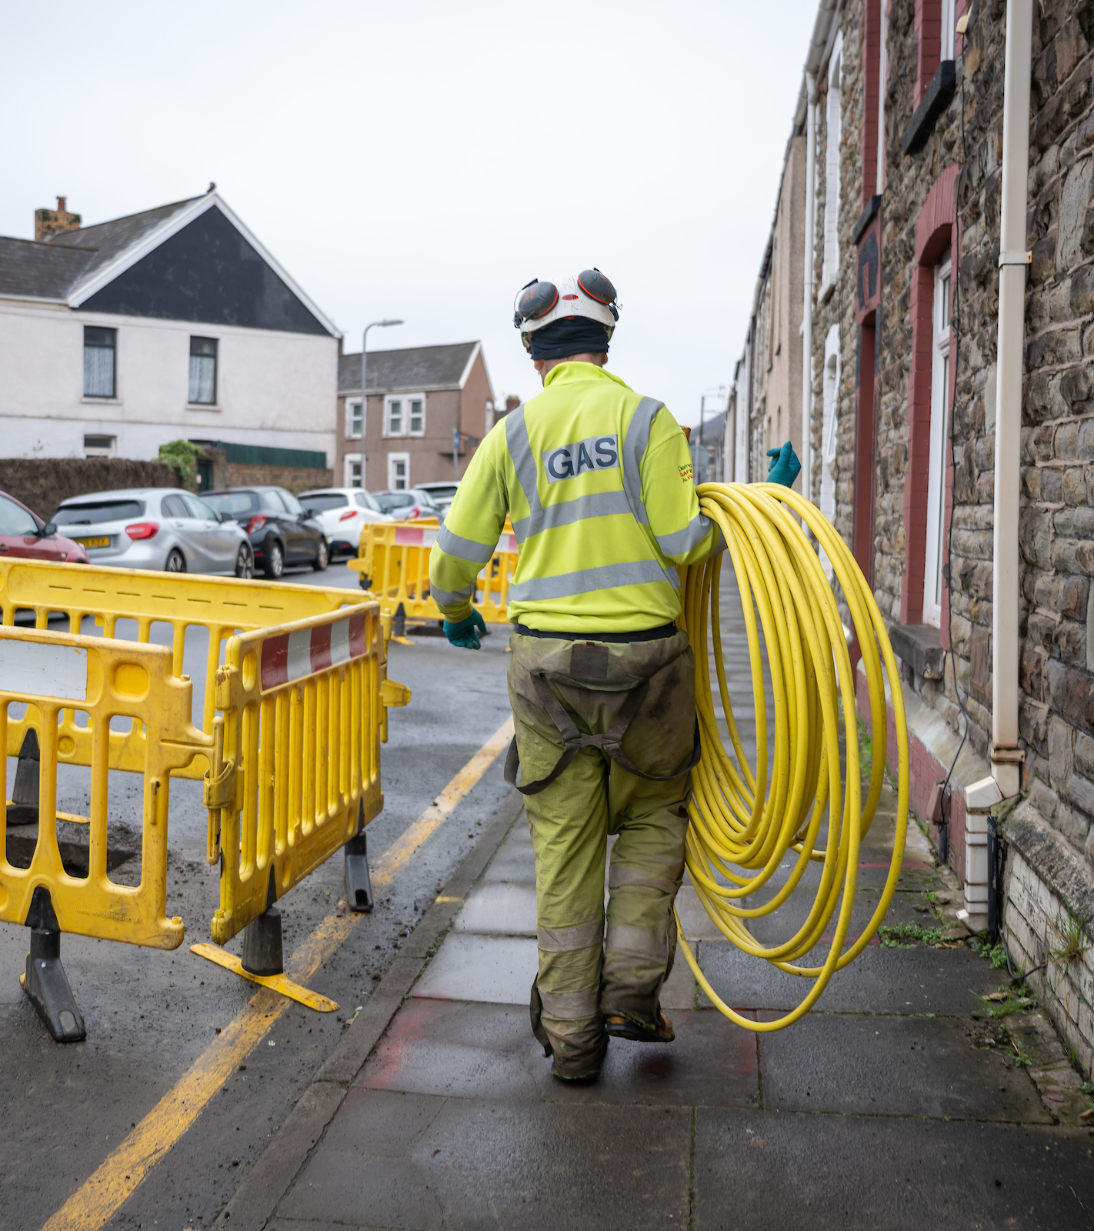
Background
Wales & West Utilities (WWU) commissioned Thinks Insight & Strategy to conduct research with members of its citizens’ panel to explore the theme of vulnerability, introduce some of the support measures in place and seek in-depth feedback on real-life customer case studies and partnerships aimed at supporting customers in vulnerable situations.
WWU has been gathering customers’ opinions on a range of issues via a Citizens Panel. Panellists have, so far, been given contextual information about the sector and so have a good idea of what the Gas Distribution Networks (GDNs) do and an understanding of WWU specifically. They have also provided feedback on decarbonisation of heat, WWU’s draft Sustainability Strategy and other themes. During these engagements Panellists expressed an interest in learning more about and providing feedback on WWU’s vulnerability service provision.

Slide 5
Methodology
Private & Confidential
Following a top-up session to onboard new members to the Citizens Panel, 31 members took part in an online engagement event on Wednesday 9th August.
Panel top up
29th June
Vulnerability workshop
9th August 2023
Introduction to WWU as a Gas Distribution Network (GDN)
Discussion of WWU’s roles and responsibilities
Opportunity for Q&A with WWU
Introduction to WWU’s services and processes to support customers in vulnerable situations
Scenarios of real-life case studies
Partnerships of WWU with other organisations and partnerships to support people in vulnerable situations

Slide 6
Sample overview
Total number of participants: 31 | 7 | 11 | 13
Location | North and Mid-Wales | South Wales | South West England
Age (spread) | 28-69 | 21-71 | 18-73
Gender | 5 female, 2 male | 6 female, 5 male | 7 female, 6 male
Ethnicity | 6 participants from a minority ethnicity
Other | All use gas, mix of homeowners and tenants, mix of socioeconomic group (SEG) and household income, representation of people with long-term health conditions and disabilities, majority bill payers.

Slide 7
02 Key findings

Slide 8
Key findings
1
2
3
Customers spontaneously have a broad understanding of vulnerability, inclusive of a range of circumstances which are all seen as legitimate and deserving of support.
Their expectations of WWU support services for customers in vulnerable situations are low, which means they are pleasantly surprised to find out about them. This information feels positive and exciting.
However, thinking and hearing about what this support looks like in real-life scenarios makes many customers question the boundaries of WWU’s safeguarding and support responsibilities.
4
5
6
In communicating the funding of these services to customers, it will be important to be live to public perceptions of the oil and gas industry. While the cost of support to each customer is perceived to be low, the current cost of living in combination with record profits for gas suppliers makes this a sensitive topic.
Customers identify a clear tension between providing what seem to be ‘charitable’ services (i.e. going beyond gas safety) and being a profitable business.
Working with partners is therefore seen as a positive and appropriate approach and customers are keen to see these projects more widely advertised.

Slide 9
03 WWU’s vulnerability services

Slide 10
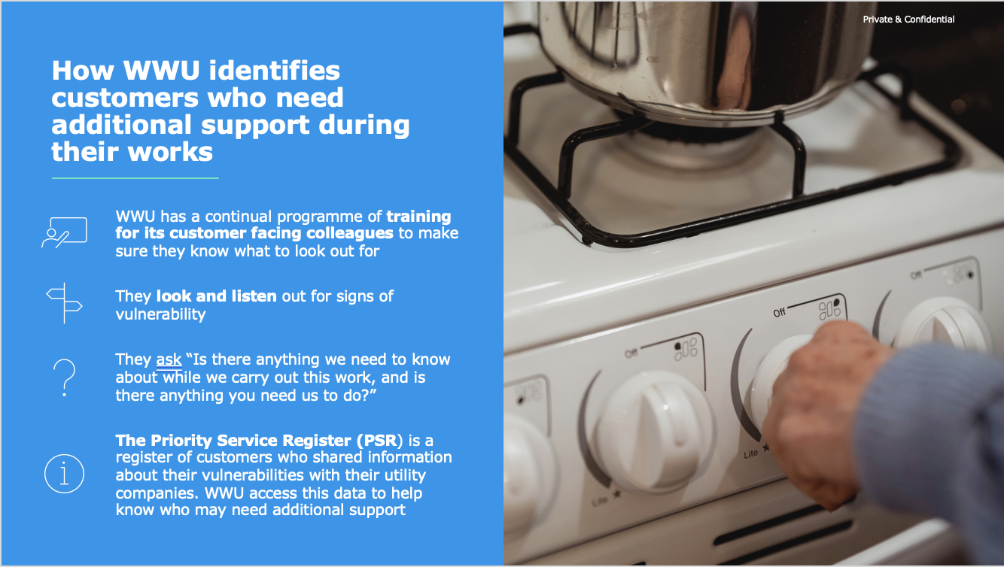
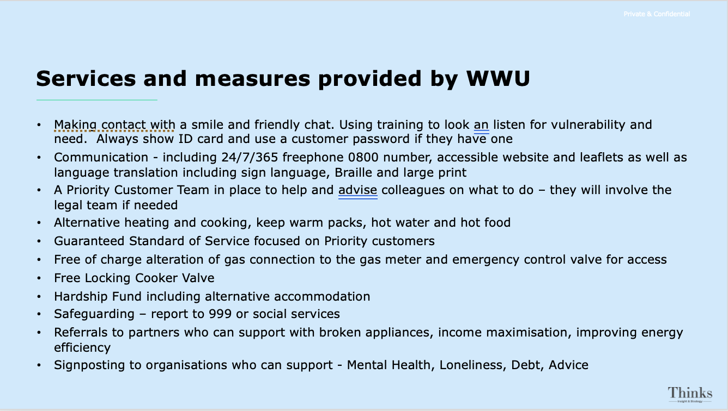
Participants were shown information about how WWU identify customers in vulnerable situations and the support they offer
Stimulus

Slide 11
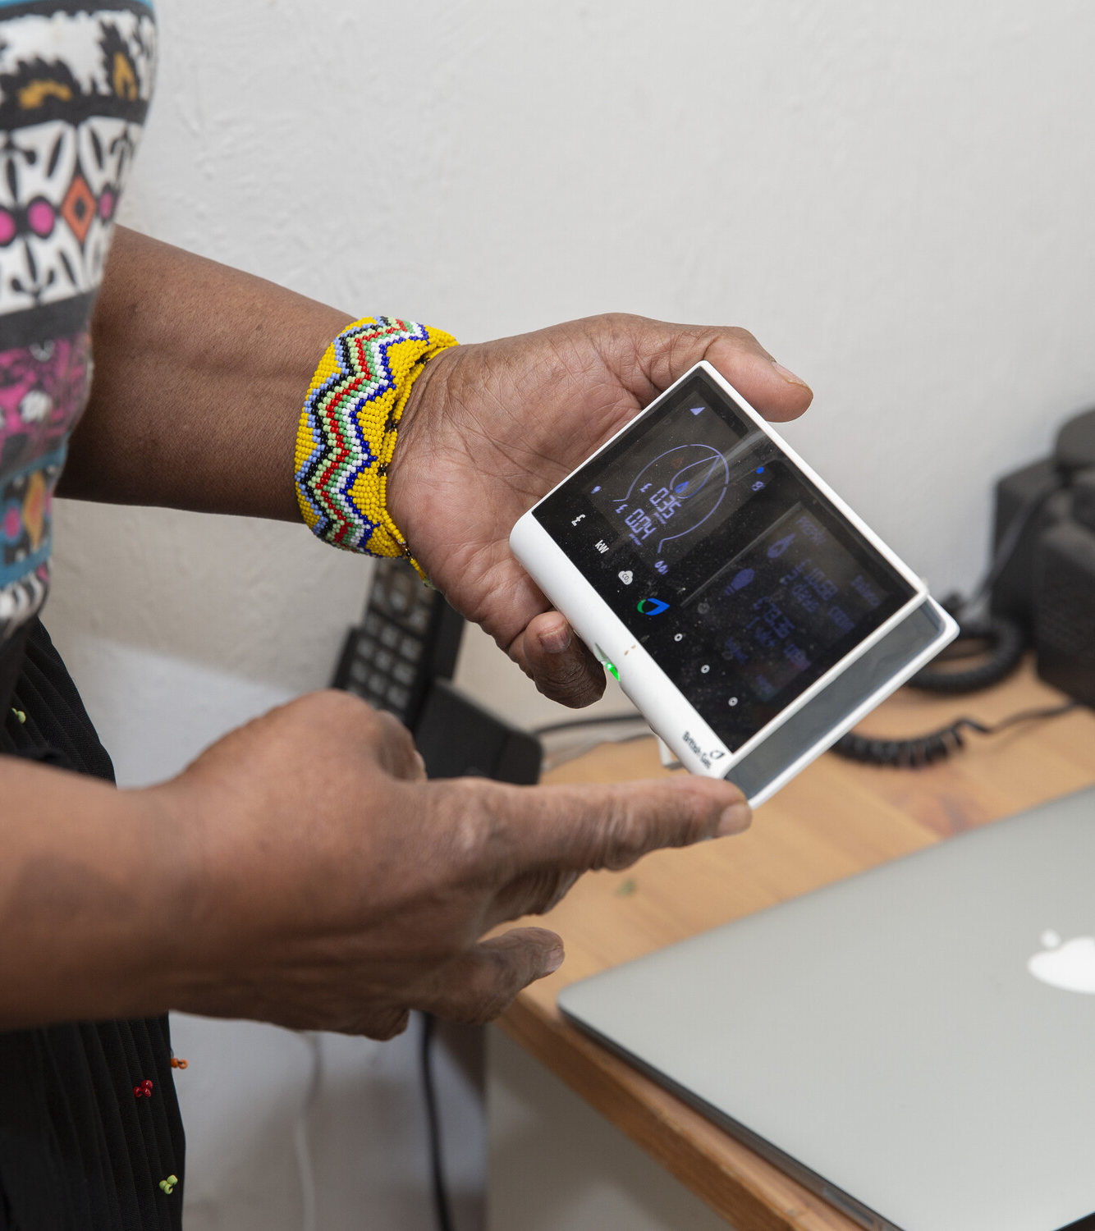
Customers have a broad understanding of what ‘vulnerability’ means
Customers demonstrated a comprehensive understanding of vulnerability, with a strong emphasis on the mentally or physically disabled and the elderly as their primary concerns.
After deliberation, they also contemplated the less obvious indicators of vulnerability, such as individuals who have lost their jobs or lost their partner. These forms of vulnerability are regarded as more situational, leading customers to believe that anyone could potentially experience vulnerability at some stage in their lives, rather than it being an intrinsic characteristic.
“
“Someone who has a disability of some sort, and it might not be a physical disability like mental health problems. Anybody elderly, or maybe someone who lives alone without support.”
“
“
“Someone who’s vulnerable could be almost anybody like someone who has been widowed or recently lost their job. There’s almost no categorising of vulnerability.”
“

Slide 12
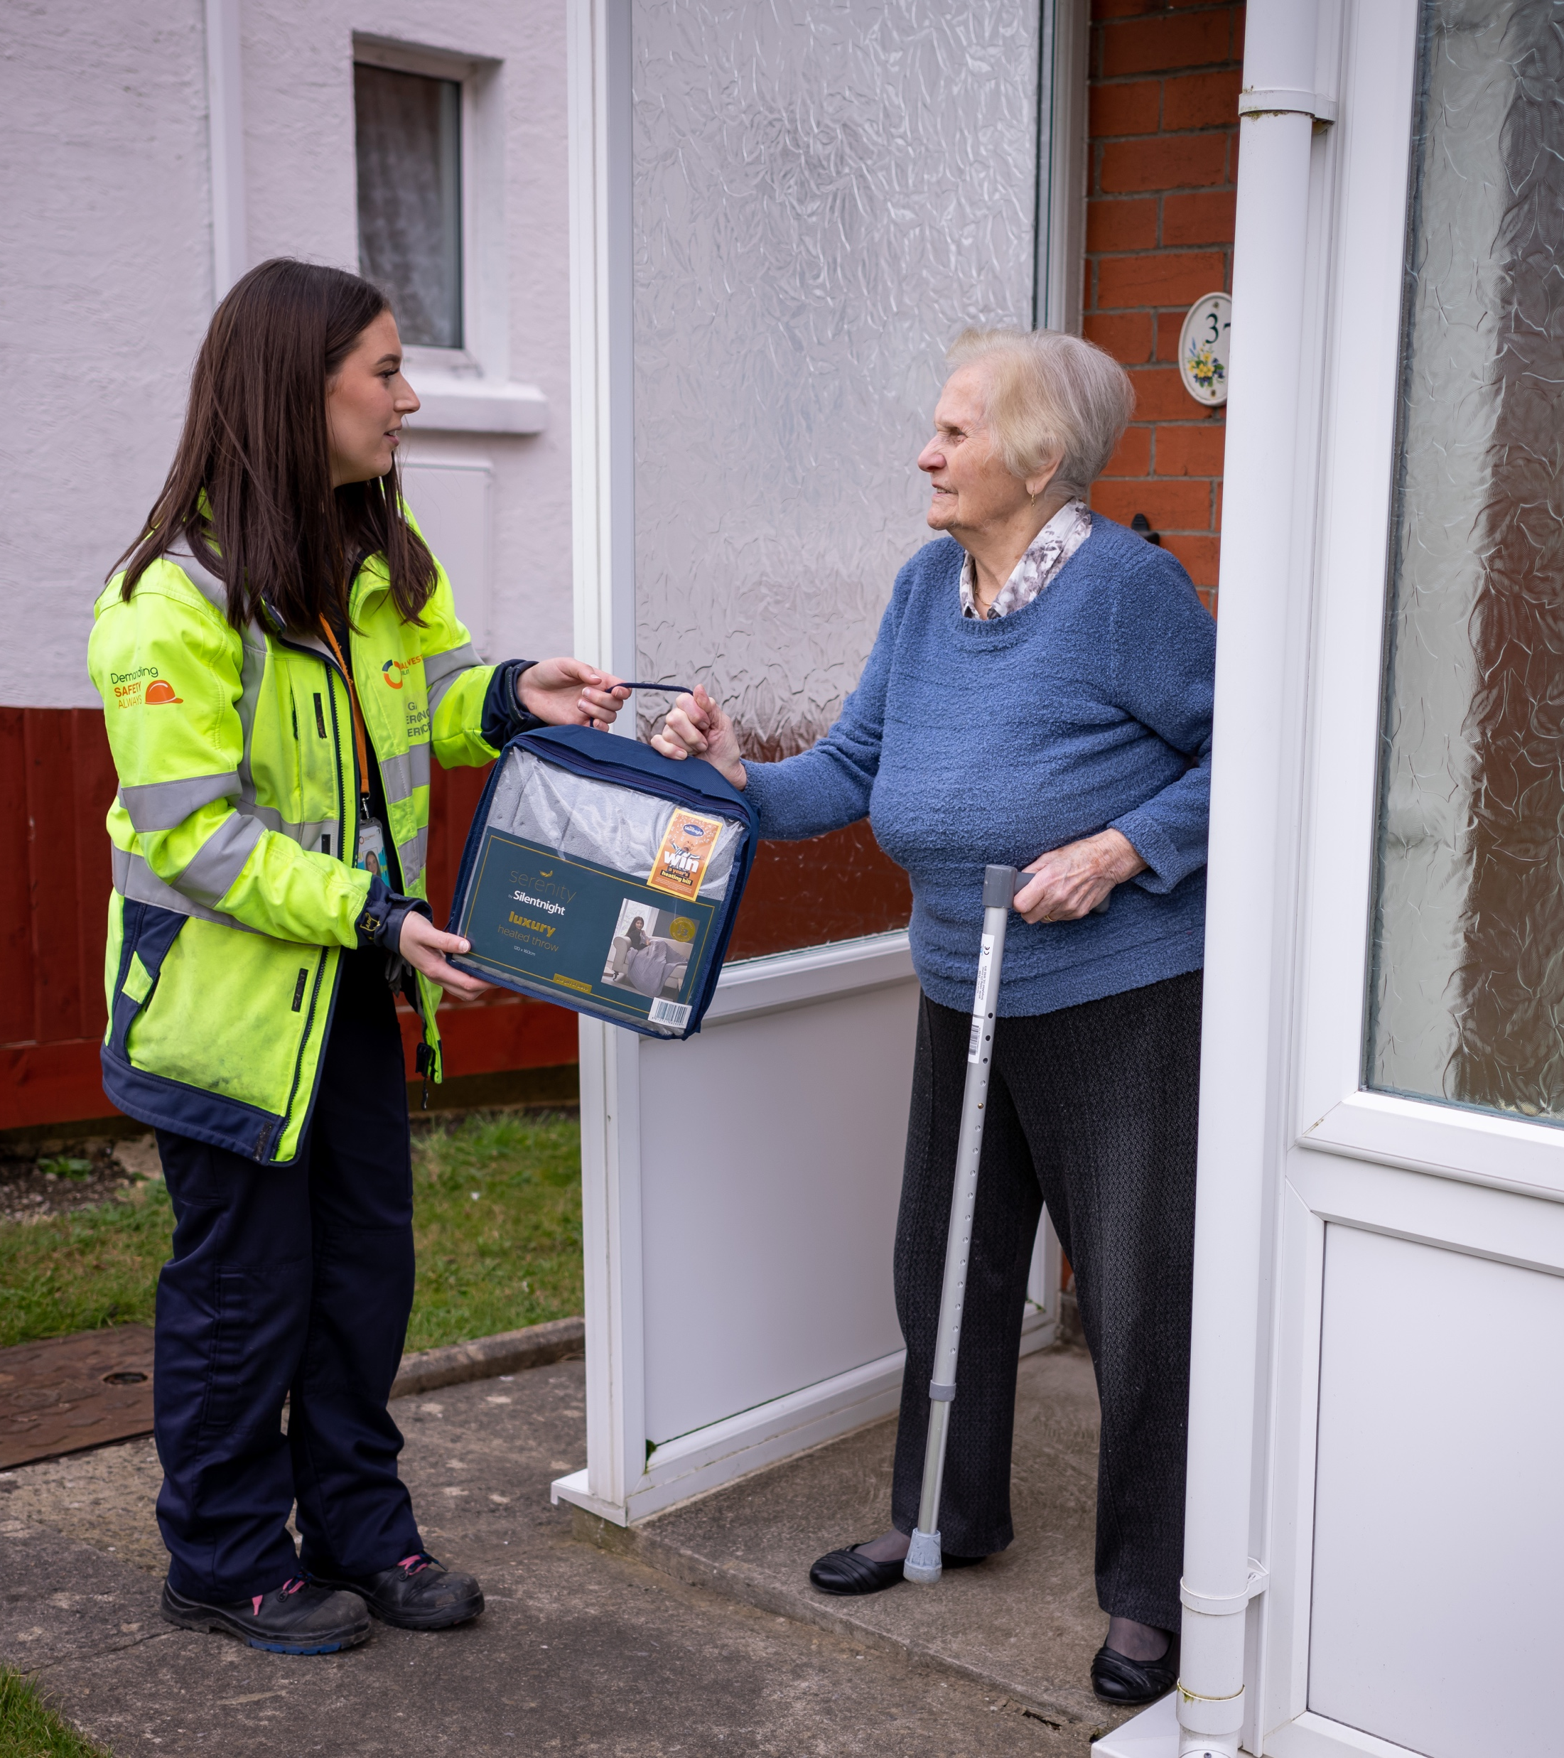
Customers are pleased to hear about the Priority Services Register…
Customers understand that WWU doesn’t have much contact with customers, so they may not know who is vulnerable until they visit a customer’s home due to an emergency.
Initial awareness and understanding of the Priority Services Register (PSR) is low, but customers are pleased to hear that this information is shared with WWU by other utility providers. This means WWU can proactively support customers who might not be aware of the services they offer, and WWU can identify those who need support.
“
“Instead of speaking to a person or making your own judgement, when they [WWU] get there, they know what they’re coming in to and they know what to do. I think it’s really good”
“
“
“I think it’s really reassuring. The best thing is that you can share it with other utilities as well and it’s out there to help the individual. I think it’s really encouraging”
“

Slide 13

…but are concerned that this might miss some customers in vulnerable situations
“
“Instead of speaking to a person or making your own judgement, when they [WWU] get there, they know what they’re coming in to and they know what to do. I think it’s really good”
There is a concern that the PSR does not identify every customer who is in a vulnerable situation, as vulnerability is often hard to define, so some people may miss out on support because they don’t fit into certain categories.
There is also a concern that some customers, particularly older customers, may not admit that they are vulnerable out of pride. In addition, some customers may not even be aware that they are in a vulnerable position.
Conversely, some customers are offended that WWU enter customers’ homes and would assume vulnerability. They identify a tension between invasiveness and proactive safeguarding.
“
“
“
“A lot of people who are vulnerable don’t accept that they’re vulnerable… also some people our age fall foul of stupid scams”
“I think it’s really reassuring. The best thing is that you can share it with other utilities as well and it’s out there to help the individual. I think it’s really encouraging”
“
“Someone who has a disability of some sort, and it might not be a physical disability like mental health problems. Anybody elderly, or maybe someone who lives alone without support.”
“
“
“
“Old people don’t want to ask for help, they just struggle and keep on going.”
“
“
“
“
“Someone who’s vulnerable could be almost anybody like someone who has been widowed or recently lost their job. There’s almost no categorising of vulnerability.”
“We’re all vulnerable in some way. I worry that people who have jobs may not be considered vulnerable, even though they’re struggling too.”
“
“

Slide 14
Many customers ignore letters from companies they don’t recognise, especially when not addressed to them directly
“
As there is generally low awareness of WWU among customers, some explain that they would discard communications from WWU assuming it was a sales letter from a gas provider. They explain that they are only interested in letters that come from their utility providers that they recognise, as they may contain information about their bills.
Some customers explain that they ignore letters completely, and instead rely on apps and emails to manage their utility bills. They suggest WWU work with gas providers to add information onto their apps/email communications in order to engage customers.
“If it’s got a relevant logo on the front of it then I will open it, otherwise it’s going straight in the bin.”
“
“
“I don’t read letters from utility companies; I just use their apps to look at my bills.”
“
“
Customers are fairly split on whether they open letters addressed to the occupier, but are overall more likely to open a named letter. There is a sense that having their name on the letter makes the communication feel more legitimate, and this can help to mitigate against the assumption that letters from WWU could be a scam or a sales letter. However, customers don’t think this is something that WWU should prioritise spending money on.
NB. In one group it was discussed that if it is made clear on the outside of the envelope that the letter is about a disruption to their gas supply, customers would likely open it.
“I never open letters that don’t have my name on. I assume that if it’s important, the company will know my name and details.”
“

Slide 15
Customers are pleasantly surprised to hear about the range of support offered, but question whether it is appropriate for WWU to offer all of these services
“
“It’s put my mind at ease knowing that if I’m ever in that situation, there’s a lot of help available.”
Overall, customers are pleasantly surprised by the range of support offered to customers in vulnerable circumstances by WWU.
Customers who don’t consider themselves to be vulnerable at the moment like the idea of WWU’s vulnerability support providing a ‘safety net’ that can support them in case they find themselves in a vulnerable position in the future.
However, there are questions about whether it is appropriate for WWU to offer all of these services as they are a gas distribution network. They expect this kind of support to be offered by their energy supplier, and prior to hearing about WWU’s support, customers explain that they would have contacted their supplier and not considered contacting WWU.
“
“
“I think it’s quite a lot considering you’re not actually paying your bill to these people. They only get a small slice, but it feels like they offer a lot.”
“
“
“It’s very impressive, especially when they could pass this responsibility onto the supplier rather than take this on themselves.”
“

Slide 16



The Hardship Fund stands out as the most impressive support offered by WWU
“
Participants are surprised by the Hardship Fund and the services this includes, such as free accommodation for customers while work is carried out at their property. They feel this is a particularly generous service from WWU.
Customers are interested to hear about free locking cooker valves, with many unfamiliar with what they are. Customers with elderly relatives, are those who work in adult care, are pleased to hear that these are freely available to ensure those who suffer with dementia. but are concerned about the fact they hadn’t heard of this offer before.
Customers are also pleased to hear that WWU signposts customers to organisations who can support customers in vulnerable situations such as mental health charities, as this indicates that WWU care about the wellbeing of their customers.
“That bit about the alternative accommodation for someone who’s vulnerable and off grid for a while… that’s something I never knew about but I think it’s really good.”
“
“
“I work in social care and the free locking cooker valve would be really useful for the people I care for who suffer from dementia.”
“
“
“I think it’s very good, especially the signposting, that is always something good for them to know.
“

Slide 17
04 Responses to scenarios

Slide 18
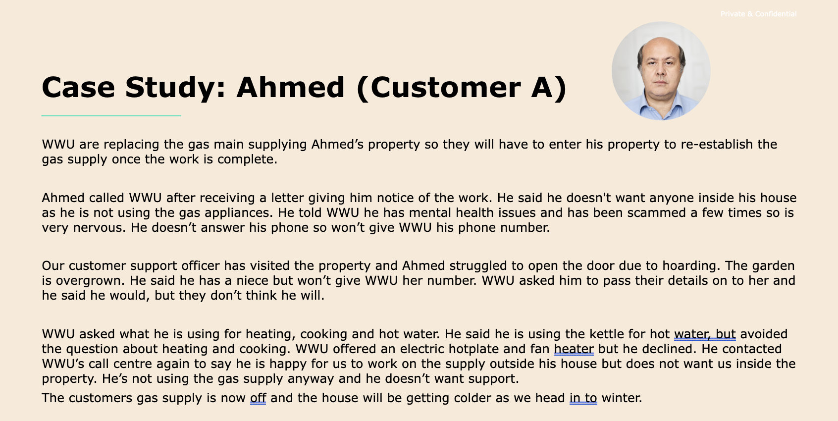
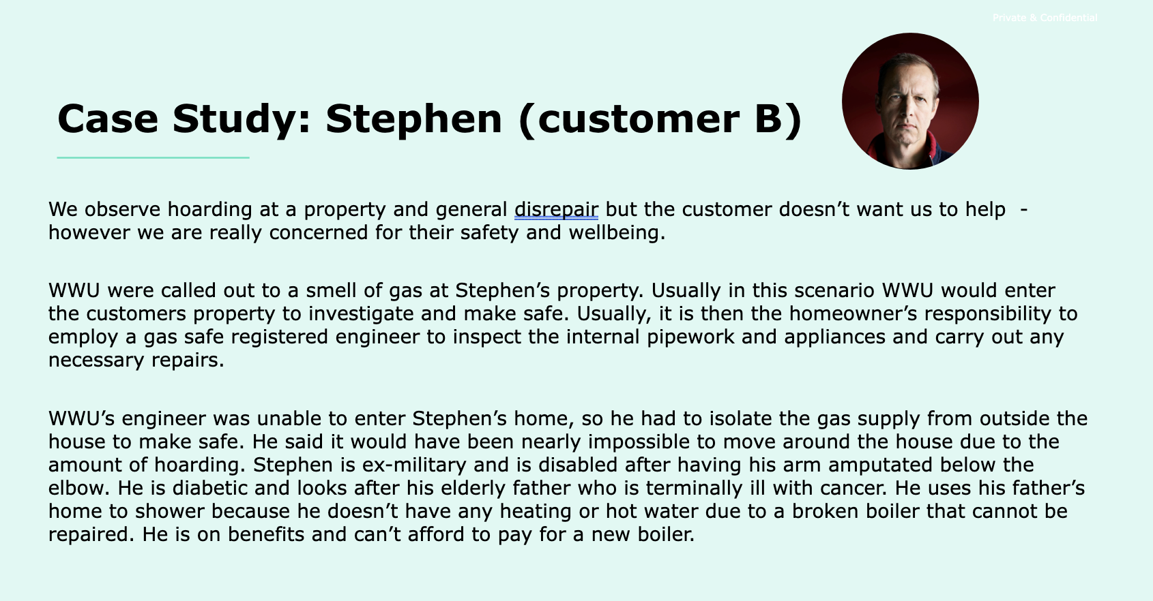
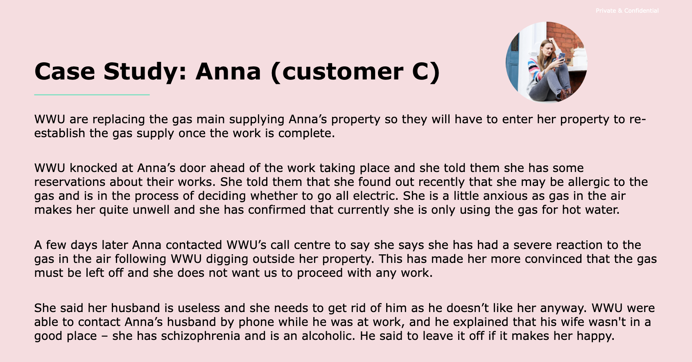
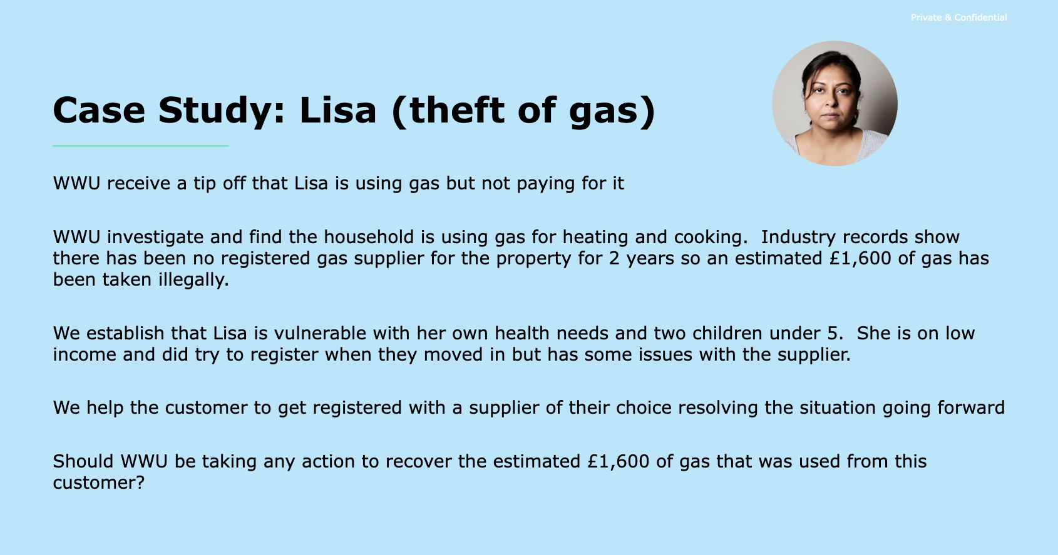
Stimulus
Participants were introduced to 4 case studies illustrating the types of situations faced by WWU

Slide 19
Customers appreciate WWU’s proactive efforts and care for customers in vulnerable situations, though some feel there should be a limit
“
Customers express admiration for WWU’s proactive efforts and commitments as demonstrated in the case studies.
Broadly, they believe it to demonstrate a genuine commitment to helping those in vulnerable circumstances, even in situations where this is difficult.
Customers do not necessarily think about the potential gas safety implications of not intervening and so hold reservations about WWU overstepping boundaries of privacy.
“It’s nice to know there is safeguarding out there – really happy for them to know it’s available.”
“
“
“It’s great they tried, though if they’ve done as much as they can, they should just leave it”
Key suggestions:
Appropriate boundaries: Customers recognise the balancing act between proactivity and invasiveness in supporting customers
Long-term support: Customers emphasise the need for sustainable long-term support that extends beyond immediate interventions but do not see this as WWU’s responsibility
Empowerment: Some mention that those most vulnerable may not appreciate assumptions being made which can disempower and make those in vulnerable situations feel targeted. It is suggested that WWU should empower their customers by providing more information on support services offered and signpost to organisations which deal with some of the root causes of vulnerability.
“
“
“I feel like this is great I couldn’t think of anything else to add. Anything beyond this could be a bit invasive. I like that they give the customers the chance to open up with everything”
“

Slide 20
Many see a need for boundaries, highlighting that WWU is a gas business and not a public service
Personal boundaries and the specific role of WWU as a business was a theme brought up often while exploring each scenario and again later when speaking about WWU partnerships.
Blurred lines: invasion of privacy vs. safeguarding
Thin line: Business vs. charity
Although customers theoretically value a proactive safeguarding approach, the case studies prompted discussions of how far WWU can take this responsibility before it becomes invasive.
The situations outlined are seen to require nuanced handling and there are situations which WWU is not seen to be qualified to deal with (e.g. complex mental health matters).
For example, in Case Study C, some participants felt that contacting the customer’s husband was a step too far and could be considered invasive.
There are some fundamental questions about whether a business such as WWU should be taking on responsibilities seen to be more suited to public- and third-sector organisations.
Although not all customers immediately make this connection, it also raises the question of who pays for these services and what WWU’s motivations for providing them are, given they are a for-profit organisation.
“
“
“Apart from the hardship fund and signposting these people to agencies who can help, I don’t think they’ve [WWU] got any further obligation.”
“WWU isn’t part of the National Health Service!”
“
“

Slide 21

As a result, many believe that WWU should focus on referrals and signposting
While appreciative of WWU’s support and efforts, most feel that beyond basic safeguarding, they should focus on working closely with organisations that provide professional support. They feel that WWU has a responsibility to ensure that customers receive help, without necessarily providing that help themselves.
As such, customers see a clear role for WWU in signposting and referring customers in vulnerable situations to appropriate public or third-sector services (e.g. relevant local charities or social services in more serious cases).
Signposting was also mentioned as important to avoid making assumptions or stereotyping vulnerable customers. A one-size-fits-all approach to support is seen to potentially cause more damage and offence.
“
“I think WWU’s duty of care ends once they’ve contacted the authorities.”
“

Slide 22
Customers strongly feel that theft of gas, even if inadvertent, should be discouraged
The “theft of gas” case study is received differently from the others, which may, in part be related to the labelling of the situation as ”theft”, which for many is a clear-cut crime.
Customers, who have all been affected by recent high energy prices, bring to this scenario a sense of morality and judgement, rather than necessarily compassion.
They feel WWU should recover the funds, partly “out of fairness” and partly to make a point and avoid setting a precedent for the future. Only a couple of participants thought the debt should be forgiven.
However, the majority do concede that the vulnerable individual should not be expected to pay back the amount owed in one lump sum, but rather should be put on a payment plan.
“
“If this is not handled properly, everyone’s going to be at it… Ultimately, it’s theft.”
“
“
“Could they work out a payment plan for her, potentially?”
“
Please note that despite explanation, there was still some confusion about who is theoretically owed the money and how the individual in the case study was able to use gas without a supplier in place.

Slide 23
05 Working with partners

Slide 24
Customers feel partnerships are an appropriate and impactful way for WWU to deliver support
While impressed by the many avenues of support offered by WWU directly, most think that a line should be drawn, and cases handed over to proper experts when need reaches a certain point. This was particularly emphasised when it comes to a customer's mental and physical health.
Participants are relatively clear on who they would turn to for support, as many have done so in the past:
“
WWU isn’t part of the National Health Service, they’re not clairvoyant, they can’t treat everybody as if every customer, every call, every person they go to has got all the issues […] One of the things that would be great if all the utility companies could share into one register*, I think that would be very helpful.”
Sources of support
For help with paying bills: Most agree that their energy suppliers would be their first point of contact.
For formal support: Participants mention social services, Citizens Advice, charities such as the Royal British Legion, Age UK, and NSPCC, as well as debt management services. They suggest WWU could signpost to or collaborate with these services.
For informal support: Participants mention family, friends, and community groups. A handful of customers feel that WWU could more proactively engage with these in specific circumstances (e.g. complex needs).
“

Slide 25

The collaboration with Maggie’s Cancer Trust is positively received, though it raises questions of awareness, scope and funding
Customers understand that cancer can be devastating for families, so any emotional or financial support is viewed very positively.
They are happy to know that WWU is aware of the difficulties people might face towards their utility bills when going through hard times and would like to see partnerships like these expanded.
“
“Something they could do is advertise what they do and offer. These services aren’t super advertised; I’ve never seen any more information about this. Be more proactive so people know even if they are not currently vulnerable. “
Positives
Participants who know people who have had cancer are disappointed that they had never heard about this, and suggest better communication about support, especially since people who go through difficult times might find it difficult to navigate all of their options.
Some customers show hesitation towards these partnerships, particularly towards where the funding was coming from for them.
A handful note that this support doesn’t feel as relevant to everyone, and that bigger partnerships should focus on things that support a wider range of people, such as those with financial difficulties.
“
“
I think it’s brilliant, I think it’s quite uplifting actually. People with cancer must be going through a terrible time, to not afford to heat their house and worry about things like that, I think if you can take that worry away, it’s one less burden on their minds, so I think it’s really commendable.
Concerns
“

Slide 26

A partnership with Citizens Advice intuitively makes sense and is seen to potentially reach a wider range of WWU customers
Participants refer to previous case studies when hearing about the partnership with Citizens Advice, which resurfaced discussions about personal responsibility and WWU’s responsibility.
Overall, many are very favourable towards this, viewing it through the lens of the cost-of-living crisis, with a particular concern about fuel debt and protecting people in vulnerable situations.
Many note that there is a clear role for WWU in this partnership, and that it feels like a “natural” pairing
They welcome that this could be helpful for anyone, not just those with specific characteristics.
“
I think this is good. Citizens Advice can also help to refer people to other services they might need.
Positives
“
“
The money to fund this is coming out of my wages which pays the bills!
As with the Maggie’s partnership, there is some hesitation and questions as to where the funding for this was coming from.
Concerns
“

Slide 27
While most are happy to contribute to fund support measures, perceptions of profits within the oil and gas industry can cause feelings of resentment
“
Most people are willing to pay more money towards WWU support and partnerships, especially once finding out how little it costs them per annum.
    However, some are surprised to find that this is something they have already been funding, seemingly without being told.
Further, in the current context of high energy costs, combined with reported record profits for some oil and gas companies, the question of funding immediately prompts comments about company bonuses and profits.
    This is further exacerbated by poor understanding of WWU’s business model and how this relates to gas suppliers.
I didn’t know that I was paying for this. I understand why but why aren’t I told that I’m contributing this?
“
“
You’ve got to be so careful about what you spend these days […] I feel bad saying that I wouldn’t be willing to pay extra, that’s not to say that one day I wouldn’t be in that category and I might need help, but I’m just saying that they have to be very careful about what they consider is affordable to people, and where they draw that line of vulnerability”
There is an overall tension between providing what seem to be ‘charitable’ services and being a profitable business, with many expecting WWU to set clear boundaries and roles for themselves.
“

Slide 28
06 Key findings: recap

Slide 29
Key findings
1
2
3
Customers spontaneously have a broad understanding of vulnerability, inclusive of a range of circumstances which are all seen as legitimate and deserving of support.
Their expectations of WWU support services for customers in vulnerable circumstances are low, which means they are pleasantly surprised to find out about them. This information feels positive and exciting.
However, thinking and hearing about what this support looks like in real-life scenarios makes many customers question the boundaries of WWU’s safeguarding and support responsibilities.
4
5
6
Customers identify a clear tension between providing what seem to be ‘charitable’ services (i.e. going beyond gas safety) and being a profitable business.
Working with partners is therefore seen as a positive and appropriate approach and customers are keen to see these projects more widely advertised.
In communicating the funding of these services to customers, it will be important to be live to public perceptions of the oil and gas industry. While the cost of support to each customer is perceived to be low, the current cost of living in combination with record profits for gas suppliers makes this a sensitive topic.

Slide 30
07 Appendix: stimulus

Slide 31


How does WWU deliver support?
  WWU have a fund paid for through people’s energy bills that they spend on supporting those most in need and to share messages on carbon monoxide awareness.
  WWU run a variety of projects across our network and with other networks across the UK to support people. Some services are delivered by WWU staff and engineers but the majority are through partnerships.
  Additional services include:
Domestic customers pay 50p a year through their gas bills to fund these services
Crisis support through fuel vouchers
Tackling fuel poverty through income maximisation
Helping customer access funding for energy efficiency measures
Educating customers on safe and efficient use of their gas appliances
Funding repairs and replacement of gas appliances to those not in need
Raising awareness of carbon monoxide and providing free monitors
Energy and safety education to schools, students and adults with learning difficulties

Slide 32
WWU and Maggie’s Cancer Trust
A cancer diagnosis can have a devastating impact financially as well as emotionally. Research by Macmillan Cancer Support found that on average, people are £570 a month worse off because of their illness.
WWU works with Maggie’s Cancer Trust to provide training to their benefits advisors, staff and volunteers around the priority services register (PSR) and Vulnerability and Carbon Monoxide Allowance activities (VCMA).
Maggie’s advisors then provide holistic support to individuals helping to lift them out of fuel poverty, maximise their income and access the correct benefits and grants available to them.
Project at a glance
Duration: Originally 1 year extended to 18 months
Investment: £50,000 (+25,000 for extension)
Forecasted that every £1 spent will result in wider social benefits of £22.35
Status: Exceeding target
Key achievements
Households reached: 1,852
Energy conversations: 1,852
Benefits received: £2,122,880

Slide 33
WWU and Maggie’s Cancer Trust: Case study, Swansea
Matthew, 58, who has a head and neck cancer, came into the center seeking help to appeal a decision not to award him Personal Independence Payment (PIP) – extra money to help with everyday life if you have an illness, disability or mental health condition.
Treatment and surgery had left Matthew breathing through his neck, following a full laryngectomy, which his means he is unable to communicate verbally. He had made the initial application himself and was refused.
Following his appointment with Maggie’s Cancer Trust, an advisor helped him lodge an appeal and went through the process of obtaining specialist information from oncologists, speech therapists, as well as psychologists and nutritionists. The advisor compiled evidence and sent it to the tribunal service. The tribunal hearing happened eight months later, with the advisor accompanying Matthew as his representative.
This work resulted in his PIP being awarded at the appropriate rates and backdated to his date of claim, meaning he had a back payment of over £6,500. His PIP was set at over £6,000 a year. Maggie’s support has given Matthew some guaranteed financial stability.

Slide 34
WWU and Citizens Advice
Citizens Advice provides free and independent advice to millions of people in England and Wales each year, over the phone and in person. Through its Energy Advice Programme, the charity helps vulnerable people access expert energy advice, get better energy deals and improve their household income.
Together, WWU and Citizens Advice co-designed an energy safeguarding programme that expands on the charity's existing service to help more low-income households across England and Wales at a time of exceptionally high demand.
Through their partnership, they’re also able to address a knowledge and skills gap within the organisation to enable its energy advisors to also raise awareness of the dangers of carbon monoxide (CO).

Slide 35






WWU and Citizens Advice: partnership impact
For each client provided with energy and CO advice this year, their support has led to an average income gain of £835. Over the entire 15 month programme to date, they have supported 20,488 clients and achieved an income gain of £7,056,535 for these households.
Their holistic support is improving the mental and physical health of thousands of households across the country – 69% of clients reported that their programme has had a positive impact on their health and/or improved their confidence and ability to manage their issues.
Households reached: 16,800 | Energy advice sessions: 6,904 | Carbon monoxide (CO) alarms provided: 4,933 | CO awareness conversations: 16,800 | Priority Services Register (PSR) registrations: 7,173 | Benefits advice: 9, 584 | Locking cooker valve (LCV) referrals: 48

Slide 36
WWU and Citizens Advice: Case study
Mr B is a single man living in a one bedroomed ground floor housing association flat. His only income is £130 per week from employment support allowance. He has limited capability for work due to depression and anxiety.
Mr B was referred to us by his housing provider and initially he was not answering his phone so we contacted him by text to encourage engagement. Once he knew we were friendly and there to help we arranged a home visit to pick up information on energy and water bills. At this time we were also able to check that Mr B had a working carbon monoxide alarm (provided by housing association) and went through with him why this was important.
Mr B had debt with his fuel supplier and water company, and owed £33 on an old store card. We were able to apply for a grant to write off the outstanding debt. We also applied to the water company, successfully wrote off a small debt and secured a discount going forward.
We also arranged for Mr B to access his local food club.
At the end of January we heard that the PIP application had been successful and Mr B will be receiving an extra £600 per month, increasing his income by over 50%.
Fuel Debt written off: £300
Water Debt written off: £30
Other Debt written off: £33
Water discount for year: £150
Personal Independence Payment (PIP) additional annual income: £7200

Slide 37

Thank you
hello@thinksinsight.com
T: +44 (0)20 7845 5880
www.thinksinsight.com
Thinks Insight & Strategy
West Wing
Somerset House
London
WC2R 1LA
United Kingdom
For more information on this report, contact:
Andy Barker | abarker@thinksinsight.com
Teresa Kuhn | tkuhn@thinksinsight.com
Jowan Taylor | jtaylor@thinksinsight.com

