Slide 1




Wales & West Utilities
are on a mission to raise awareness of carbon monoxide and it’s dangers
This pack contains important safety information to help you stay safe from this dangerous gas.
At the end of this pack you’ll have all the information you need to take part in the national CO Safety Competition and possibly bag yourself some money!

Slide 2



Carbon
monoxide
(CO)
“Get Creative Be Safe” Pack

Slide 3


What is Carbon monoxide (CO)?
Carbon monoxide is a poisonous gas…
Because you can’t…
• hear it
• see it
• smell it
• taste it
• touch it
It’s invisible!

Slide 4



How do we know CO is there?
The only thing that can tell us if CO is there is a carbon monoxide alarm
Hands up if you have a CO alarm at home
It’s important to have one of these in our homes as it will be able to tell us if there is a problem with CO.

Slide 5


How is CO made?
Carbon monoxide is made when anything that burns like wood, gas and coal, doesn’t burn correctly.
It’s made when they don’t have enough air to escape or if an appliance is broken and leaking.

Slide 6


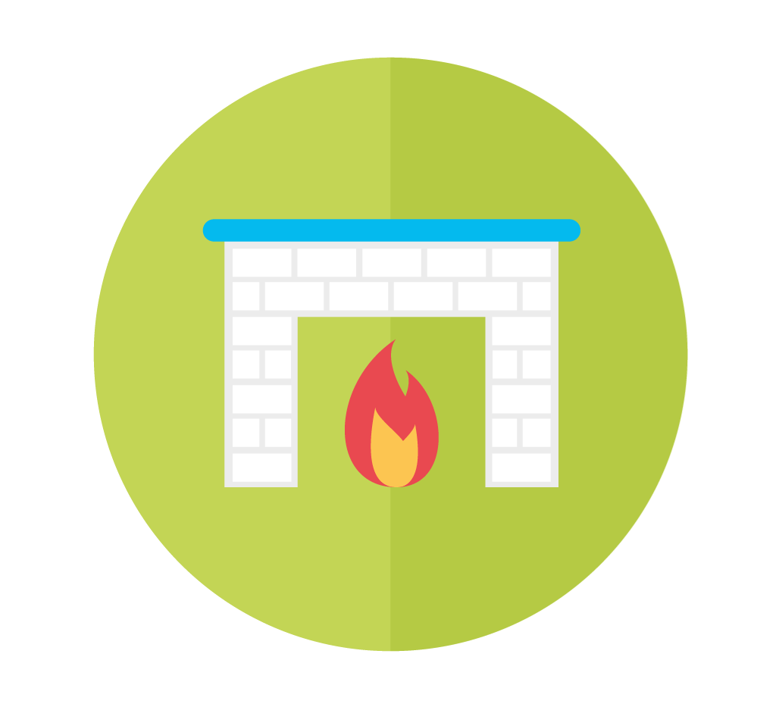

Where does CO come from
in our home?
Any guesses?
Cookers
Boilers
Fireplaces
BBQs

Slide 7



What can we look out for?
Flames on our cookers & boilers
should be crisp and blue
If your cooker or boiler is giving off CO then the flame will be orangey/red
Cookers
It’s important we have our appliances checked every year to make sure they are safe!
Boilers

Slide 8
What can we look out for?
The smoke from your fireplace goes up and out of the chimney if it’s nice and clean
If your chimney is blocked then the smoke cannot get out – this can cause carbon monoxide
Fireplaces
Orangey
/red flames
in our fireplaces are okay!
It’s important, if we use our fireplaces, to have our chimneys swept annually
to keep them clean!

Slide 9
What can we look out for?
Using a BBQ safely outside is good
If we brought the BBQ inside, this can cause carbon monoxide
BBQs
Never bring a BBQ
indoors, even in a tent!

Slide 10
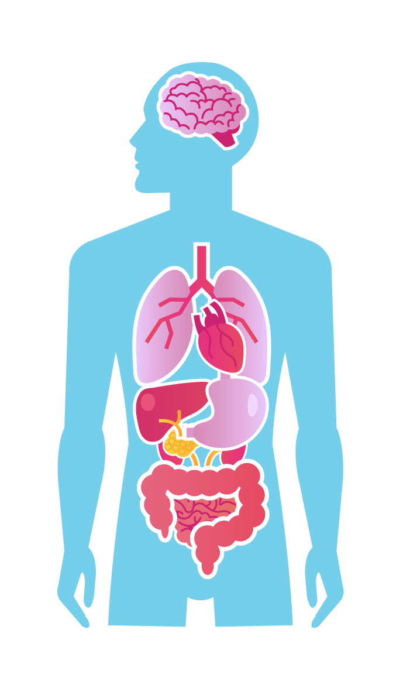



How does oxygen
get into our body?
When we breath in oxygen, it gets picked up by red blood cells
The red blood cells travel through our veins and delivers the oxygen to our organs
This makes us fit and healthy!

Slide 11

How does CO
get into our body?
Can you name any organs?
Brain
When we breath in CO, it gets picked up by red blood cells
The red blood cells travel through our veins and delivers the CO to all our organs
Lungs
Heart
Stomach
Liver
This makes us feel poorly
Kidneys
Small intestine

Slide 12

How does CO make us feel?
CO will make us feel very poorly if we breathe it in. It will make us…
• Sick
• Dizzy
• Have a headache
• Out of breath/tired

Slide 13


What can we do if
we think there is CO?
If you think there is CO then call the National Gas Emergency Number straight away on…
0800 111 999
Only call this number if there is a gas emergency

Slide 14
Recap?
Remember, CO is short for carbon monoxide
Carbon monoxide is a poisonous gas…
CO can come from…
Because you can’t…
Hear it
See it
Smell it
Taste it
Touch it
Cookers
Boilers
Fireplaces
BBQs
• A good flame is blue
• A bad flame is orange/red
• We need our appliances checked every year
• We need to keep our chimneys clean
• Never bring a BBQ indoors
A CO alarm will tell us if we have a problem with CO
CO will make us feel poorly and give us:
If you think you have a problem with CO then call the National Gas Emergency number straight away on: 0800 111 999
• A dizzy feeling
• Sickness
• A headache
• A bad stomach

Slide 15
Quiz time!
Remember, CO is short for carbon monoxide
1. Can you smell carbon monoxide
2. What can we buy that will tell us if we have CO in our home?
3. Name the 4 places that CO can be found in the home
4. Where should we never bring a BBQ?
5. What colour should the flames be on our cooker?
6. What colour is the flames on our cooker if there’s CO?
7. How does CO make us feel?
8. What is the National Gas Emergency Number?

Slide 16
Answers!
1. Can you smell carbon monoxide
No, it’s invisible!
2. What can we buy that will tell us if we have CO in our home?
A Carbon monoxide alarm
3. Name the 4 places that CO can be found in the home
Boiler, BBQ, Cooker & Fireplace
4. Where should we never bring a BBQ?
Indoors/in a tent
5. What colour should the flames be on our cooker?
Crisp and blue
6. What colour is the flames on our cooker if there’s CO?
Orangey/Red
7. How does CO make us feel?
Poorly, sick, headache, dizzy etc.
8. What is the National Gas Emergency Number?
0800 111 999

Slide 17

We’re looking for creative
kids to design a poster, poem
or film to raise awareness of a poisonous gas, called carbon monoxide (CO). The competition
is open to children aged 5 – 11 and there are some great prizes up for grabs – for the running pupil and their school or organisation,
such as Cubs or Brownies.
Visit our website for more information:
wwutilities.co.uk/GetCreativeBeSafe

Slide 18
Hints and tips for your entries
• Make them as creative as possible,
remember it’s a competition!
• Make sure the information is correct
• Use plenty of colour and pictures
if you’re designing a poster
• Make sure your designs are neat
and tidy
• Don’t forget to put your name,
age and school on your entry!

Slide 19

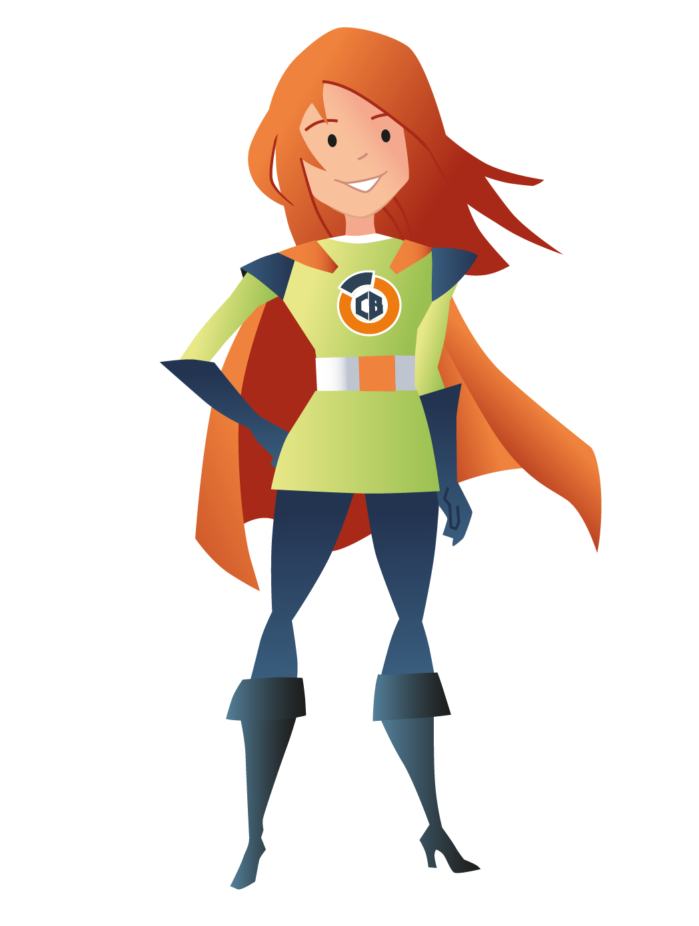

Finished your posters?
Why not play our COde Breakers game to be in with a chance of winning an iPad!
Crack the COde!
We’re the Codebreakers, and we’re
on a mission to raise awareness of carbon
monoxide (CO) – and we need your support!
Take a look at the information and help us
‘Crack the COde’ by playing the game.
Play the game

Slide 20
Other useful information
All entries and questions can be emailed to: COSafetyCompetition@energynetworks.org
& gasambassador@wwutilities.co.uk
Visit our website for more information
We also deliver FREE CO safety sessions** for pupils.
For more information please email gasambassador@wwutilities.co.uk
or call 02920 278536
**Subject to the availability of our gas safety ambassadors

