Slide 1
Annual Stakeholder Workshop
May 2017
Exeter

Slide 2
Introduction
Neil Henson,
Director of Finance

Slide 3
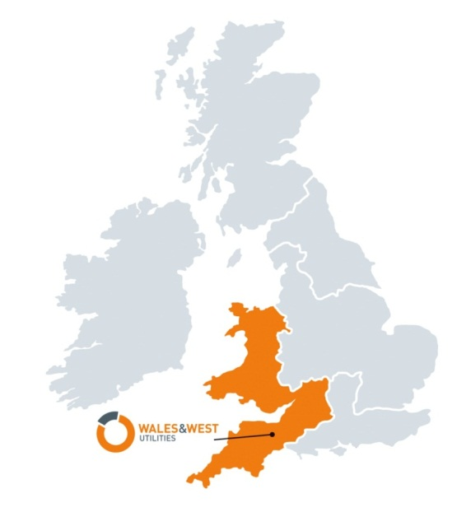
Wales & West Utilities
We don’t sell gas; we transport it through our 35,000km network of pipes
We invest £2m a week connecting new homes & businesses to our gas network & upgrading old metal pipes to new plastic ones
We employ more than 1370 people & have a contract workforce of around 600
We keep 7.5m people safe and warm – with levels of service, safety and reliability they can trust
We respond to more than 80,000 gas emergencies a year
We are the gas emergency and pipeline service for Wales and the south west of England
We are regulated by Ofgem
We are a values-driven business – safety is our number one priority and our customers are at the heart of everything we do
Notes:
Overview of who we are and what we do, for those who aren’t aware
This slide is self explanatory along with a little bit more history around how we have moved on from being British Gas
Wales & West Utilities (WWU) began operations on 1 June 2005 after the gas distribution network was sold by National Grid. We’re a regulated business, operating around 35,000 kilometres of gas pipelines, serving 2.5 million homes and businesses across Wales and the South West of England and we provide the Gas Emergency Service. Etc…..
Gas distribution network (GDN) that transports gas to homes and businesses across the whole of Wales and the south west of England.
Regulated by Ofgem (Office of Gas and Electricity Market).
Head Office in Newport, South Wales, Deploying circa 2,000 people across Wales & the South West of England including contractors
In 2012 we became a part of the Cheung Kong Infrastructure Family (CKI). They are a leading player in global arena with diversified investments in:
Energy Infrastructure
Transportation Infrastructure
Water Infrastructure; and
Waste Management
Brief description of operations :
Build & Replace Teams
Carry out all repairs to our network gas mains and services and complete all new customer connections work. They also help with the delivery of our Replacement and Capital programmes, to make sure that we can supply all future gas demand across Wales and the South West From Colwyn bay to Penzance. They also provide logistical support, by keeping our teams supplied with materials for job completion and reinstatement.
Emergency Metering Services Teams
Will deal with all aspects of emergency and metering activities, both regulated and unregulated. Our First Call Operatives (FCOs) carry out around 80,000 metering jobs for NGM each year, making a significant contribution to our company’s unregulated income. All of our FCOs are gas safe registered, and carry out a range of services including:
attending reported escapes
installing and repairing pipework
resetting, repairing and replacing gas meters
carrying out checks for safety, and
reconnecting customers after service relay or mains work.
Network Services
Carry out the maintenance, construction and protection of above and below ground natural gas assets, this is critical to the safe supply of gas to customers in Wales and the South West of England. Within our company, a dedicated team of Staff, Industrial Staff and Contractors undertake this work and also provide a round the clock fault and emergency response service.
Another key element of the Above Ground workload is the provision of maintenance services to National Grid Metering, National Grid Transmission and other large gas consumers. These fully commercial contracts provide valuable non formula income to WWU and the Above Ground Team are committed to delivering a high quality service to these important customers.
Operations Health, Safety and Environment (HSE)
The HSE team supports our company’s ‘Demanding Safety Always’ priority - making sure that our workforce can work safely, and promoting good health and wellbeing.
In addition, we make sure that our process safety operations don’t negatively impact on the environment, or our excellent reputation for operating a safe and reliable gas network. We have a team of HSE professionals that will strive to improve Our Operations HSE Performance by:
introducing compliance guidance, based on changes to legislation
monitoring performance against set targets
carry out inspections/audits and feedback on performance
promote initiatives to help us deliver performance improvement
identify priorities based on Operational risk
produce and deliver an annual Operational HS&E Improvement Plan
influence the culture of the operational workforce by promoting health and wellbeing
helping to deliver the Ofgem Safety Outputs and Company Safety targets
Other areas of the business that also provide a vital service to both our internal and external customers
Health Safety & wellbeing
HR Inc.… corporate affairs and external relations
Finance
Business services Inc.… IT
Asset

Slide 4
4

Slide 5
Business performance update – outputs 2016/17
Safety
Met both our key emergency standards
Well ahead on 8 year iron mains risk removal targets
Met our “1 in 20” capacity obligation
Maintained operation performance
Currently reviewing supply interruptions targets with Ofgem as part of the MPR parallel work
Customer Service
Improved overall broad measure score from 9.05 to 9.13 – further improvement required on our Planned scores
Complaints handling performance results in no penalty
Reduced leakage by more than annual target
Delivered on our fuel poor commitments for the year
Continue to be at the forefront of promoting awareness of carbon monoxide
Social obligations
Met all connections guaranteed standards of performance
Environmental
Reliability
5
We continue to achieve all our RIIO outputs - and are on course to achieve the 8 year RIIO targets

Slide 6
Our portion of the customer bill
£126
£121
The start of current PCR
2013
2017
We’re doing what we can to keep customer bills as low as possible – just like we said we would!

Slide 7
Purpose of today
To provide you with an update on what we’ve been doing over the last regulatory year
To get your views on what we have planned

Slide 8
Westbourne
Who we are
Housekeeping
Agenda

Slide 9
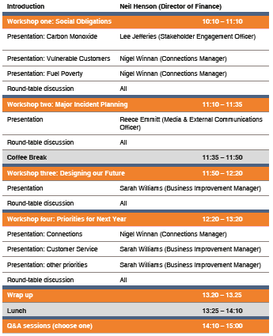
Agenda

Slide 10
Workshop One: Social obligations

Slide 11
Carbon monoxide poisoning prevention & awareness
Lee Jefferies,
Stakeholder Engagement Officer

Slide 12
Carbon monoxide – what you said
Do more to promote this topic by attending events, conferences, country shows etc.
Target all outreach activities to those people most at risk
CO alarms should be rolled out – and promoted – as much as possible
Do more to engage with politicians
Do more to spread awareness of this topic amongst school children (in a way that is engaging)
Work in partnership with other organisations
Notes:
Across all workshops, stakeholders told us that raising awareness of CO should be our top priority
Educating a range of audiences such as children, those most at risk and hard to reach, was vital

Slide 13
Carbon monoxide – what we did
Revised CO strategy
Strategic approach to CO school safety competition
New online educational game and face of CO
New approach to events
New partnerships

Slide 14
Revised CO strategy
Targeting those most at risk of the dangers of CO:
Under 14 and over 65
Vulnerable
Live in a CO ‘hot spot’
An area that receives a high percentage of CO-related call outs versus number of properties in the area
Provide CO alarms to the following since March 2017
Customers we sign up to the Priority Service Register – 510
Customers we provide a Free of Charge gas alteration – 32
All new starters – 88
Provided 5,496 CO alarms last year – an increase of 234 alarms (4%)

Slide 15
School CO safety competition
Thorough communications plan created:
Celebrity endorsement – Ex-Lions and Wales rugby player, Tom Shanklin
Targeted Facebook promotion – seen by more than 153,000 people
General and more localised press releases issued
More than 2,000 letters sent to all primary schools in Wales & south west England
Internal promotion: posters, emails, text messages and so on
More than 225 entries received – an increase of 288%

Slide 16
Crack the COde & the COdebreakers
New online educational game created, promoted on social media
Fronted by Chloe & Ben – the COdebreakers
Since we launched the COdebreakers:
More than 37,000 people have seen our promotional Facebook post;
More than 235 people have ‘Cracked the COde’; and
National Energy Action have asked if they could integrate it into their training.
The COdebreakers are being rolled out across all of our CO-related materials
We have shared the COdebreakers approach with the other Gas Distribution Networks
www.wwutilities.co.uk/crackthecode

Slide 17
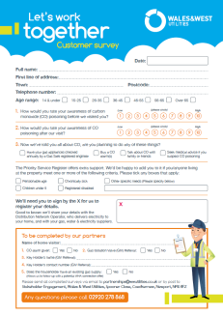
New partnerships
Created four new partnerships – help us promote the services we offer our vulnerable customers:
North Wales Fire & Rescue – NEW
Mid & West Wales Fire & Rescue – NEW
Gloucestershire Fire & Rescue – NEW
Cornwall Fire & Rescue – NEW
South Wales Fire & Rescue – EXISTING (enhanced)
Devon & Somerset Fire & Rescue – EXISTING (enhanced)
Avon Fire & Rescue – IN PROGRESS
Expanded the services promoted:
CO awareness
Warm Home Assistance
Priority Services Register
Gas Isolation Valves
Creating a new ‘Partners Pack’ to make sure all partners provide their customers with accurate, consistent information

Slide 18
Events
Had a presence at Royal Welsh & Royal Bath & West Shows, attended by more than 370,000 people and provided around 2,700 CO alarms
However:
CO alarms weren’t going to the right audience, nor did they provide value for money
We will continue to attend shows – albeit on a smaller scale and no longer providing alarms – sharing a stand with our local Fire & Rescue partner
Trialled raising awareness at smaller events in CO ‘hot spots’ - Rhiw, Bridgend in March – 426 alarms issued 34% of which were to residents in CO hotspot postcode CF31
New approach

Slide 19
Political influencers
We attend the All-Party Parliamentary Carbon Monoxide Group (APPCOG) – chaired by Barry Sheerman MP – on a quarterly basis.
We use it as a place to share best-practice and influence policy
This year we, as Gas networks, were due to launch the CO safety awareness at festivals event on 6 June – but it has been postponed due to the snap election

Slide 20
Carbon monoxide – what we have planned
CO
Increase the number of targeted, smaller scale events we promote CO at
Identify and create more partnerships with organisations who can help us to promote CO awareness to house builders, other utilities, educational bodies, estate agents and landlords
Update politicians about CO incidents, specific to their constituency, on an annual basis
Incorporate ‘Safety Seymour’ – an educational programme aimed at primary school children – created by Cadent (formerly National Grid)
Start the CO schools safety competition earlier and identify organisations who can help us to push it further
Continue to promote the COdebreakers
Trial smart CO alarms

Slide 21
Vulnerable customer support
Nigel Winnan,
Connections Manager

Slide 22
Vulnerable customer support – what you said
“Do more to work in partnership with other utilities such as electricity and water companies”
“The training you provide for customer-facing staff is good – do more of this”
“It is good that you are aiming to achieve a British Standard for your work on this issue”
“Build bridges with trusted organisations - including the emergency services, the charity sector and the medical profession in order to reach more people in vulnerable situations”
“The PSR App for operational staff is a good way of flagging customers in vulnerable situations”

Slide 23
Vulnerable customer support – what we did
With the support of Warm Wales, we initiated the first multi-utility (gas, water, electricity) conference, called ‘Stronger Together’ – attended by people from 106 organisations
Provided Priority Customer Awareness training to 1,250 customer-facing colleagues
1st GDN to be successfully audited against BS 18477
Integrated Priority Service Register (PSR) sign ups, Gas Isolation Valve installation, Warm Home Assistance scheme promotion and CO awareness into all key partnerships – including Fire & Rescue Services
Referred 33 customers to trusted organisations for financial and wellbeing support
PSR App rolled out across network in July 2016
referrals also collected through other customer interactions, and partners on our behalf (e.g. Fire Service) 1,541 referrals 2016, 797 referrals 2017 (Jan – Apr)

Slide 24
Stronger Together conference
Wales & West Utilities, Western Power Distribution and Welsh Water with the support of Warm Wales, coming together to help vulnerable customers
To address how communities, public and private sector organisations can work together to identify and support the most vulnerable
106 organisations attended including representatives from Housing Authorities, Local Authorities, our Regulator, charities and the voluntary sector

Slide 25
Stronger Together conference continued
Plenary session with panel of Chief Executives from the three utilities
Outcomes and next steps:
Collaborate more;
Continue work to influence regulators to have one PSR; and
Work with umbrella organisations make sure we include the most hard-to-reach/new-and-emerging groups of people in vulnerable situations

Slide 26
Priority customer training
In order to raise awareness of vulnerability and the support measures we have in place, we created a training programme and rolled out to all customer-facing back office, operational and contractor colleagues
We have seen a total of 1,250 colleagues (180 of which were from our back office), visited 19 depots and delivered more than 100 sessions
91.75% training was carried out face-to-face

Slide 27
BS18477 inclusive service provision
1st Gas Distribution Network to meet requirements of the standard
Specifies procedures for making sure services are available and accessible to all customers equally, regardless of their personal circumstances
Full audit involving 1,250 customer-facing back office, direct labour and contractor colleagues completed December 2016
More than 40 colleagues interviewed – back office, direct labour and contractors
We were praised by the auditors for:
our consistency and collaboration across the business;
the clarity in messages to customers; and
the passion shown by our colleagues in wanting to give vulnerable customers the help they need

Slide 28
Priority Service Register referrals
In May 2015 we began a PSR App trial to refer customers we identified as vulnerable to existing gas and electricity supplier Priority Service Registers (PSRs)
In July 2016 the PSR App was rolled out across our network
We’re also collecting referrals via other customer interactions & partners, on our behalf
We have a data-sharing agreement in place to begin referring customers for inclusion on Welsh Water’s PSR
To date we have referred 2,881 customers to the PSR
We are on course to refer around 4,000 customers to the PSR in 2017

Slide 29
Vulnerable customer support – what we have planned
Cross Utility Work:
More cross-utility conferences
Expand partnership network and support for our customers
Share PSR referrals with the water sector – data sharing agreement in place with Welsh Water from May 17, to be rolled out to the other water retailers
Internal Communication:
Provide vulnerable customer training to all new customer-facing colleagues
Further training for customer-facing colleagues – focus on specific vulnerabilities e.g. Dementia awareness e-learning package
3-7 July - awareness week planned to remind colleagues and encourage use of support measures available to vulnerable customers
Re-audit against BS18477 planned Nov 17

Slide 30
Vulnerable customer support – what we have planned
External Communication:
Doctor surgery pilot – stand at doctors surgeries to meet and speak to patients about the PSR and capture referrals (alongside CO and Warm Home Assistance)
Replacement letter pilot – enclose PSR leaflet/referral form with replacement notification letters to raise awareness and capture referrals – freepost address for returns
Revamp the ‘Safe and Warm’ section of our website – to include online PSR sign up form
Research:
Vulnerable customer research – views on incident support: keep warm packs, alternative heating and cooking, hot food, rest centre and washing facilities (through LRF), door knocking, customer support vehicle
Vulnerable customer mapping – identify vulnerability hotspots to tailor support and communications e.g. if we are sending notification letters to an area with a high number of Polish speakers, we could include a translation

Slide 31
Supporting the fuel poor
Nigel Winnan,
Connections Manager

Slide 32
Background
New English strategy agreed by parliament in 2015
New Energy Supplier Obligation scheme approved to run from April 2016 (ECO2T)
NEST and ARBED schemes incorporated within Energy Efficiency scheme in Wales in 2017
80% of properties in Wales are on gas and 75% in the south west of England
12% (2.7m) households in England are fuel poor
30% (0.4m) households in Wales are fuel poor

Slide 33
Supporting the fuel poor – what you said
“Your trials in Flintshire and Cardiff seem like a good idea. If they are working you should look to roll them out in more areas”
“Collaborative hubs work well to bring together people from a range of different backgrounds”
“Target those people who need assistance most”
“You should look to collaborate with other organisations including local authorities, suppliers and those in the charity sector”
“Make sure that information on what help is out there is easy to access for those in need”

Slide 34
Warm Home Assistance scheme
 | Connections | Mains laid | Notes
Original RIIO GD1 output | 10,800 | 43km | Over 13,500 connections made since 2009 plus 450 connections and 12km on ARBED 2
RIIO- GD1 4 year output | 7,350 | 34km | Compared to 4 year forecast of 7,280 to Ofgem
Revised output for RIIO-GD1 | 12,590 | 55km | Approved by Ofgem in September 2015 with additional £2.2m allowance
Minimum target for 4 years | 5,240 | 21km | Unit cost per connection £1,355
Notes:
Challenges of reducing RSL budgets and a lack of funding for new heating systems

Slide 35
Warm Home Assistance v ECO2T
Warm Home Assistance
Fund the mains and services to the property
Fund the supply to a District heating system
ECO2T scheme
Insulation measures
Repair of heating systems
Replacement boilers / heaters
New heating systems
District heat systems
We will continue to work with our fuel poor partners to develop relationships with Local Authorities, energy suppliers and other organisations, with access to the ECO2T funding, to maximise the number of connections under our scheme supported by access to low-cost loans

Slide 36
Current active collaboration
BEIS and Ofgem
Warm Wales
Welsh Government Energy Efficiency team
British Gas, EON, SSE
Flintshire, Anglesey, Cardiff, Cornwall, Neath Port Talbot councils
Speakeasy, Energy Savings Trust
SGN, NGN, Cadent (National Grid)
Northstar – PAYS loans
Wales & West Utilities

Slide 37
Fuel poor hubs
Trails in Cardiff and Flintshire are drawing to a close
£50k investment from Wales & West Utilities to win funding and support Care & Repair worker
Councils have attracted £530k in funding from National Energy Action (NEA) fund and match funding
Focused on GP referrals of those with health conditions
280 people have been engaged and received measures from financial and energy advice through to new boilers
Money and carbon savings are being calculated for final NEA report
Conclusion is that these hubs provide real support and make a difference to the most vulnerable in society

Slide 38
Communication
Warm Home Assistance scheme literature rebranded and simplified
Communicated scheme to all MPs, AMs, Local Authorities and Housing Associations
Regular articles in National Energy Action and private landlords magazines
Engaged with our Communications team to promote community events through press releases, posters and social media
Roll out of FRESH mapping data to more local authorities including Cornwall, Cardiff and Flintshire

Slide 39
Supporting the fuel poor – what we plan to do next
Initiative | Investment | Period | Customers helped
Roll out of FRESH data mapping tools to local authorities to identify vulnerable households aiding targeting of funding | £90k | 2 years | 6 councils 600 homes receiving energy efficiency measures
Expand fuel poor hubs following Cardiff and Flintshire trials (south west England and Wales) | £390k | 18 months | 6 councils 9,000 homes given energy advice 600 gas installs
Joint GDN trials of energy saving devices | £15k | 12 months | TBC

Slide 40
Questions: Social obligations
What else do you think we should include on the ‘Safe and Warm’ section of our website?
What else do you think we should be looking at?
What do you think about what we’ve already done?
What do you think about what we’ve already done?
What do you think about the other things we have planned?

Slide 41
Workshop Two: Major incident planning
Reece Emmitt,
Media & External Communications Officer

Slide 42
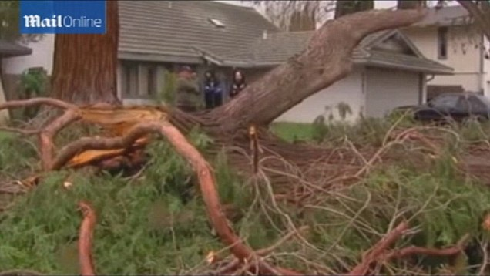
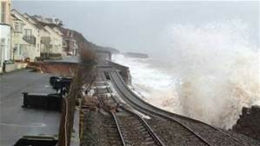
Background
DECC (now BEIS) have taken more interest in gas since storms in 2014/15
Difference between electricity/water and gas
Previously
National & local exercises
Desktop based, supply rather than customer focussed

Slide 43
Major incident planning – what you said
Planning for major incidents is vitally important and should be ‘business as usual’
We should have more knowledge of where customers in vulnerable situations are, to prioritise them in an emergency
Planning should consider a range of organisations including other utilities and emergency services
We should share best practice with other organisations
Exercises are essential to plan for emergencies

Slide 44
Planning – what we did
Set up a Major Incident team
Reviewed communications
Reviewed Operational Strategy

Slide 45
Communicating…
With colleagues…
With customers…
Early Warning Text System: Yellow/Amber/Red
WhatsApp
Reinforced customer call centre
Emergency website & social media
Media strategy – regular updates
New cards and letters

Slide 46
Vulnerable customers
Identified through the Priority Service Register (PSR)
Prioritise on smaller incidents but not feasible in major incidents – would dramatically slow process
In a major incident we’ll work with partners to meet their needs
Local Authorities and emergency services
Resilience forums
Charities/voluntary groups

Slide 47
Customer self-isolation and restoration
Switching yourself off and back on again!
Gas different to water/electric
Process agreed with Health & Safety Executive and Ofgem
Used when analytical model suggests risk from customers being off in current weather conditions outweighs risk from customers turning themselves back on
New communications pack and strategy

Slide 48
Major incident exercise
Major incident exercise
Based on loss of supply to homes and businesses in Cardiff – affecting more than 400,000 people
Exercise indicated that we could restore supplies within a week – but challenging!
Continued to evolve our plans in light of this
Sometime in May 2017, this year’s major incident exercise

Slide 49
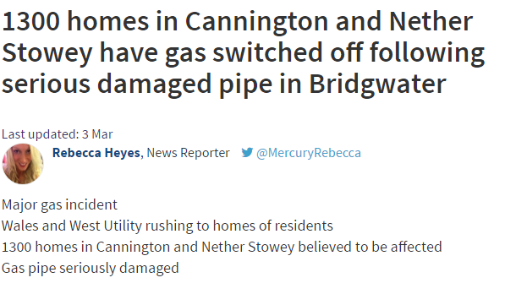
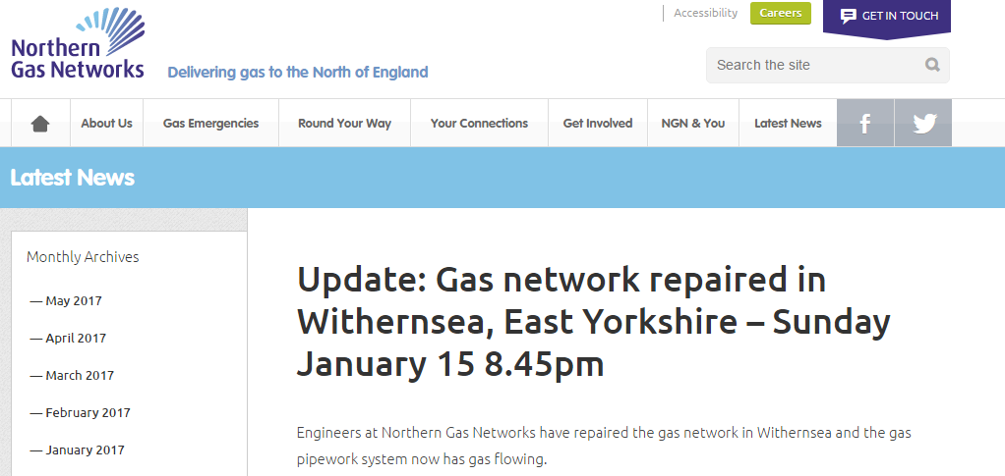
Sharing best practice
Round table event at IGEM with other gas networks
Building on experience of smaller incidents
Feedback from other networks incidents

Slide 50
Moving forward
Partnership approach to vulnerable customers
2017 major incident exercise
Continue to refine processes and develop communication
Continue to share best practice and build on experience

Slide 51
Questions: Major incident planning
Do you have any other views on what we have done / what we are planning to do / is there anything missing?
Do you agree with our external communications process, and what else could we be doing?
What do you think of the customer self-isolation and restoration packs?
Do you agree with our proposed approach to supporting vulnerable customers during a major incident?
What do you think of our proposed operational strategy?

Slide 52
Coffee break

Slide 53
Workshop Three: Lower carbon future & Meeting future demand
Sarah Williams,
Business Improvement Manager

Slide 54
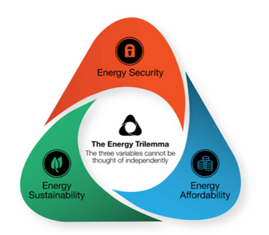
Background
The UK has set a target of reducing its carbon emissions by 57% by 2030
That means not only decarbonising electricity generation but also the provision of heat
More than 80% of heat and power demand at peak times today is met by the gas network - helping to heat homes, power businesses and keep the lights on
Unless this changes, or the gas we use is decarbonised, we will not be able to meet our carbon targets
Our energy simulator shows that the gas network is essential to support a low carbon future in a way that meets the energy trilemma – being secure, affordable and sustainable.
For a decarbonised future essential electricity and gas networks work together.

Slide 55
Development of energy networks
Key
------ Gas
------ Electricity
The energy network – last 100 years

Slide 56
Energy network – last 5 years
Hydrogen +
Tidal
-
+
An integrated energy network enables the use of renewables

Slide 57
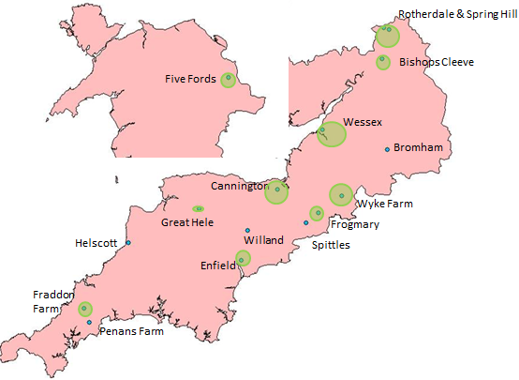
Green gas – last 3 years – biomethane
We currently have 16 biomethane connections on our network – 15 in south west England and 1 in Wales
Together they have with a maximum potential to inject 1.4 TWh
For comparison, Swansea Bay Tidal Lagoon estimated at 0.5 TWh @ £1.3b

Slide 58
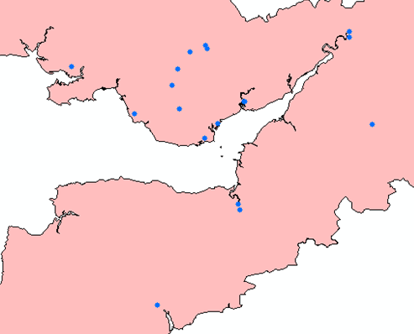
Keeping the lights on
Supporting intermittent renewable generation
14 new flexible gas power stations connected since Sept 2014
10 new sites planned
392 enquiries in last 12 months
MAP OF SITES CONNECTED SO FAR (incl. RR, AES and Severn being offered new NEXAs)
Ogmore
Sudmeadow
Bristol Rd
Dafen
Clyne
Nevern
Heol Ty Aberaman
Llwynypia
Traston Rd
Solutia
ABB Zantingh
Cynon
Larigan
Rhymney
Chippenham
Cadoxton
The Drove
Marsh Barton
Water Lane

Slide 59
Lower carbon future & Meeting future demand – what you said
You should look to raise awareness of alternative gas, particularly amongst farmers and landowners
You should host a workshop aimed solely at key players in the industry including developers, landowners and supply chain partners
You should do more to promote the benefits of alternative gas and should target Wales where take-up has been slow
You should promote alternative gas to Government and to thought leaders in the industry

Slide 60
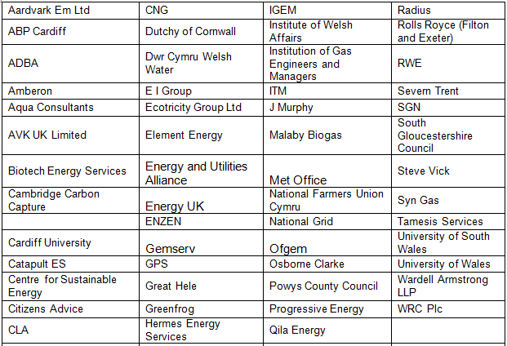
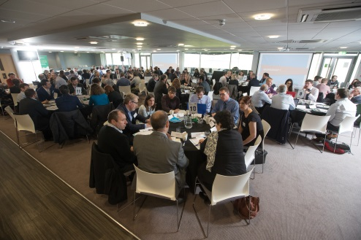
Lower carbon future & Meeting future demand – what we did
We ran an ‘Alternative Gas Workshop’
Industry-first held in March 2017
64 organisations from across the UK attended
including National Farmers Union, developers and landowners
Feedback was positive
100% of attendees said they found the ‘Very interesting’ (78%) or ‘Interesting’ (22%)
More than 40 attendees have contacted us since for more information on connecting to our network

Slide 61
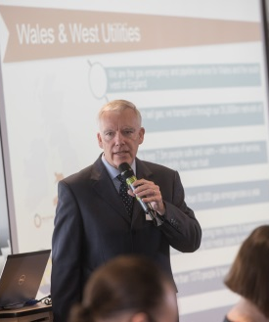
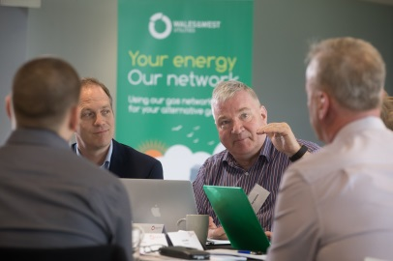
Alternative gas workshop continued
We asked how we could improve the number of connections to our network
We were asked to promote green gas further
It was suggested we utilise existing networks that can help facilitate change (i.e. Local Authorities/Councils and leaders in green energy

Slide 62
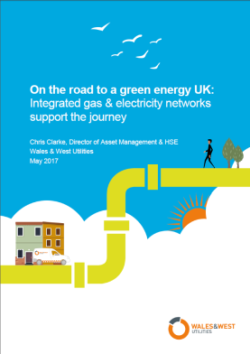
Events and communications
Lower carbon future & Meeting future demand – what we did
Hosting ‘Future of Energy’ events
Department of Business, Energy & Industrial Strategy
Ofgem
We have developed a unique Energy Simulator
Enables accurate modelling of energy supply & demands
Takes account of the needs in both summer & winter
Demonstrates the reliance on gas to ‘keep the lights on’
Keeps the customer at the heart of what we do by calculating the impact on their bills
Publications
Created a new green gas connections booklet to help make the application process easier
Produced a paper describing the road to green energy

Slide 63
Events and communications
Lower carbon future & Meeting future demand – what we did
Working in collaboration
Involved in the Flexis Project in Wales
a £25 million European funded project involving academia, local government & business
looking at the development of smart energy distribution systems
Working with Western Power Distribution on the FREEDOM project
£5m innovation project
addressing marked barrier to adoption of new low carbon hybrid heating
carbon reductions circa 50%

Slide 64
Lower carbon future & Meeting future demand – what next
Innovation projects
More efficient biomethane production e.g.
Controllable so production follows demand
From bin bag waste
Hydrogen projects
Continuing with the FREEDOM project
Stakeholder engagement
WWU events
Conferences
Supporting research groups
Bridgend
Flexis
Cardiff University

Slide 65
Questions: Lower carbon future & Meeting future demand
What do you think about our proposed innovation projects – do you think we should be doing more?
What do you think about what we’ve already done?
Should we continue to fund and support research groups?
Is there anything else we should consider?
Do you think we have the right approach to stakeholder engagement?

Slide 66
Workshop Four: Priorities for next year

Slide 67
2016/17 priorities
Below is the order you gave our priorities for 2016/17
NEW - for consideration: Customer Service & Connections

Slide 68
New priority #1 - Connections
Nigel Winnan,
Connections Manager

Slide 69
Connections business
We have an obligation, under the Gas Act and our Operating Licence, to provide connections services including to quote unless unreasonable to do so
Services include:
New services to existing, new build domestic and commercial
Service alterations
Mains diversions
Isolations of pipes and assets
Gas Connections are competitive with over 100 registered Utility Infrastructure Providers (UIPs (lay pipes which are adopted by Gas Transporters)) and six Independent Gas Transporters (IGTs) that own and operate their own networks fed by our network
We support competition through consistent treatment of third-parties through capacity checks, design approvals and adoption of pipes

Slide 70
Typical connections workloads
Worktype | Services | Mains laid | Our share of market
Existing domestic ¹ | 7,000 | 14km | 95%
New domestic | 4,000 | 23km | 20%
Non domestic | 500 | 6km | 60%
Diversions | NA | 7km | Not competitive
Alters | 3,600 | NA | 95%
Isolations | 1,100 | NA | 95%
1. Existing domestic numbers include 1,500 connections made with funding from our fuel poor scheme
We will continue to support competition in the connections business across all work types

Slide 71
The Gas (standards of Performance) Regulations 2005
Task | Maximum days under GSoP | Penalty for exceeding maximum | Performance
Provide desktop quote domestic | 6 days | £ 10 day | 99.1%
Provide quote following survey or for small commercial | 11 days | £10 day | 98.9%
Provide quote for large commercial | 21 days | £20 day | 98%
Respond to land enquiry | 5 days | £40 day | 98%
Provide planned date for works following payment | 20 days | £20-£40 day | 99.9%
Complete works on agreed dates | Meet gas on date | £20-£150 day | 96.5%

Slide 72
Our proposed changes
Propose to Ofgem that:
they reduce the ‘Maximum days under GSoP’ allowance and increase the compensation payment if we don’t meet that target
we increase the compensation payment we provide, if the customer affected by not meeting our target is identified as vulnerable
we include housing developments of more than five properties under GSoP allowance – these are currently exempt
However, we would like to increase the ‘Maximum days under GSoP’ allowance for more complex land enquiries and larger commercial jobs where the load impacts higher pressure network capacity and external costs are required from framework partners

Slide 73
New priority #2 – Customer Service
Sarah Williams,
Business Development Manager

Slide 74
Our customer service achievements
Overall customer satisfaction score of 9.13 in 2016/17
First gas network to meet the BSI 18477 standard for inclusive service position for vulnerable customers
Won 8 awards for customer service in 9 years
Over 80% of complaints resolved within 1 working day after receipt
47% reduction in complaint volumes over last 2 years
No Ombudsman complaints ruled against us for 6 years
Achieved “Distinction” status from ICS ServiceMark accreditation
Improved ICS customer focused culture score

Slide 75
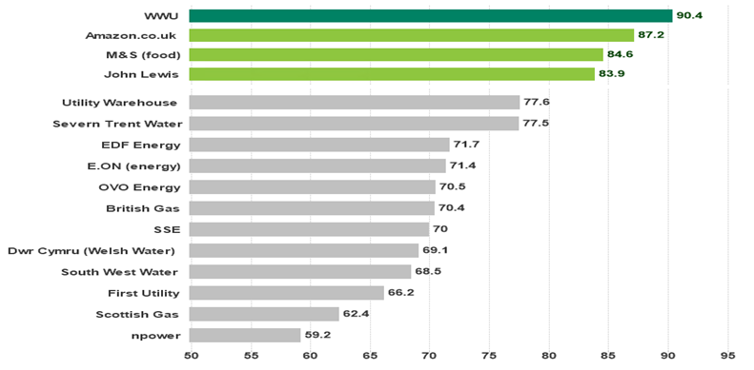
Customer satisfaction – how we compare
UK Customer Satisfaction Index (UKCSI)

Slide 76
Customer satisfaction – our challenges
Key challenges | Our response
Not having customer contact data (telephone numbers/email addresses) | Leading on an initiative of data sharing between suppliers and gas networks to improve communication with customers.
Adapting the latest technology and new ways of engaging with customers and delivering a consistent level of service | Drive to restore gas supplies by 18:00 using advances in technology to reduce interruption times
Increasing customer expectations brought about by improved offerings e.g. Argos/Amazon same day delivery | Introducing faster compensation payment methods to put things right quickly on occasions when things go wrong

Slide 77
Other priorities
Sarah Williams,
Business Development Manager

Slide 78
Innovation – what you said
You should look into partnering with universities to renew the workforce
Collaboration amongst utilities would allow them to lobby the government more successfully for increased funding
The industry should promote innovation in the gas industry more

Slide 79
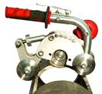
Innovation – what we did
We invest innovative solutions that are
cost-effective and reduce the time on the job
easier and safer to use to ensure fewer injuries
Two examples of our innovation include
Ductile Iron Window cutters
These allow us to safely and efficiently cut ‘Ductile Iron’
reducing cutting time by two-thirds
Saving around 30 minutes per job
Hornet Rock Drills
A rock drill on a frame that limits the vibration
Compact, lightweight and easy to move
Prevents uncontrollable jarring and potential back trauma, often seen with a hand-held pneumatic drill.
Notes:
60 DI cutters
21 Rock drills

Slide 80
Innovation – what we did
Partnership with Energy & Utility Skills – for the first ever joint Workforce Renewal and Skills Strategy for the sector
The Strategy takes the first steps towards making sure the UK’s energy and utilities sector retains a safe, skilled, resilient and sustainable workforce
Continued presence at the Low Carbon Network Innovation event – which provides us with an opportunity to explore the key learnings from electricity and gas network innovation project
Notes:
60 DI cutters
21 Rock drills

Slide 81
Protecting the environment – what you said
You should always look to minimise your company’s impact on the environment
Engagement with environmental groups is good but it should not just be for its own sake
You should talk to a range of people, not just those people who agree with you

Slide 82
Protecting the environment – what we did
Mains replacement programme ahead of schedule – replacing around 400km mains on average a year – to reduce leakage emissions
Finished our gasholder removal and remediation programme – five years early
Continue to refurbish our estate and fleet
Engaged with those outside the gas industry – including a presentation to the South West renewables conference
We are ahead of our carbon footprint reduction targets, both relating to transport and fugitive emissions
Notes:
engaged with three DNO’s (UKPN; WPD; ENW); Welsh Water

Slide 83
Smart metering – what you said
You should raise awareness of smart meters– as most people have little knowledge of this
There needs to be careful planning ahead of the smart meter roll-out. This involves a range of companies, particularly suppliers
Many people find this technology confusing. More needs to be done to explain the benefits to your customers

Slide 84
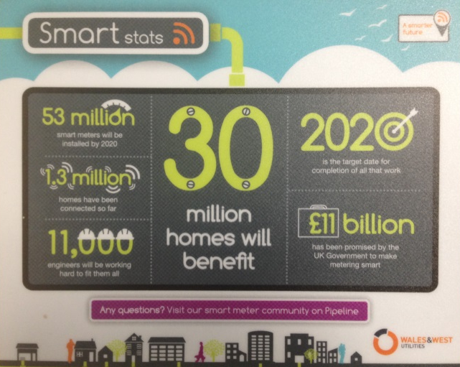
Smart metering – what we did
Colleague smart metering awareness campaign and smart metering training – 108 operatives
Won a contract to install 6,000 smart meters in Plymouth which includes providing energy advice to customers, as standard
Engaged with suppliers and the electricity operators to ensure the safe roll out of smart meters
Part two awareness campaign – website information for customers (under construction)

Slide 85
Theft of gas – what you said
We had no idea this was a problem
This issue has huge safety implications
You should work in partnership with other organisations including the police
You should look to raise awareness of this issue

Slide 86
Theft of gas – what we did
Collected more than £899,000 (inc. VAT) – almost double the previous regulatory year
Regularly promote links on social media, directing them to website to report suspected theft of gas

Slide 87
What should our 2017/18 priorities be?
Over to you! Please rate the following in priority order
Carbon monoxide prevention & awareness
Innovation
Lower carbon future
Major incident planning
Meeting future demand
Protecting the environment
Smart metering
Supporting the fuel poor
Theft of gas
Vulnerable customer support
Connections - NEW
Customer service - NEW
1 = Highest priority; 12 = Lowest priority

Slide 88
Questions: priorities for next year
What do you think of our proposed changes to the connections process?
Do you have any comments on our approach to customer service?
Do you have any comments on our other priorities – which are the most important to you?
Is there anything missing?

Slide 89
Lunch

Slide 90
Q&A sessions

Slide 91
Q&A sessions – options
Social obligations
or
Future of energy

